Slide 1

Dataframes with Tidyverse
Intro to qCMB
Kristin Fluke, CMB PhD Candidate

Slide 2
Agenda
Monday
Download the power point presentation and the RMarkdown document, Tidyverse_HW.rmd, and toy datasets. Put everything in the same folder.
Follow along with the live demonstrations
Wednesday
Finish presentation, complete HW individually or in a group.
Knit your assignment to PDF or HTML and submit on canvas
Friday
I am available to help! I will hold office hours after CMB seminar
AZ H210, 11am-1pm

Slide 3
Dataframes
A data structure
2-dimensional table of rows and columns (like an excel spreadsheet)
One of the most common data structures; flexible and intuitive
Data types:
Character (chr; “hello world!” )
Factor (fctr, categorical; up/down, +/-, A/T/U/G/C)
Numeric (integer/int, double/dbl, floats, longs, etc)
Boolean (bool, True/False, 0/1, yes/no)
date/time
null/missing values (NULL or NA)

Slide 4
df [18x4]
Column names (header)
 | date | instructor | topic | HW Due
1 | 01/17/22 | NA | NA | NA
2 | 01/19/22 | David | Intro/syllabus | NA
3 | 01/24/22 | Erin | R/Rstudio | NA
4 | 01/26/22 | Erin | R/Rstudio | NA
5 | 01/31/22 | Brooke | Rmarkdown | Assignment 1
6 | 02/02/22 | Brooke | Rmarkdown | NA
7 | 02/07/22 | Jessica | Biological data/genome data | NA
8 | 02/09/22 | Jessica | Biological data/genome data | Assignment 2
9 | 02/14/22 | volunteer | Student vignettes | Assignment 3
10 | 02/16/22 | volunteer | Student vignettes | NA
11 | 02/21/22 | Kristin | Tidyverse | Assignment 4
12 | 02/23/22 | Kristin | Tidyverse | NA
13 | 02/28/22 | David | CMD1 | Assignment 5
14 | 03/02/22 | David | CMD1 | NA
15 | 03/07/22 | David | CMD2 | Assignment 6
16 | 03/09/22 | David | CMD2 | NA
17 | 03/14/22 | NA | NA | NA
18 | 03/16/22 | NA | NA | NA
Row index

Slide 5
What data types is each column?
character ( “hello world!” )
factor (ordered catagorical data)
numeric (integer, double)
dates and times
null/missing values (NA)
 | chromosome | genomic_coordinate | nucleotide | strand | upstream_sequence | seq_length | sequence_frequnency
1 | 3 | 25136245 | A | + | AGTCATGCTG | 10 | 0.002
2 | 4 | 8692145 | T | - | TGCTGGTC | 8 | 0.134
3 | 2 | 69314589 | G | + | GCTAGTCAAAC | 11 | 0.894
4 | x | 93148894 | C | - | AGCTCGAAA | 9 | 0.000

Slide 6
Wide format Long format
Multiple data points (observations) per row
One data point (observation) per row
observations
group | replicate | observation
control | 1 | 12
control | 2 | 11
control | 3 | 14
treatment | 1 | 29
treatment | 2 | 21
treatment | 3 | 27
group | Replicate 1 | Replicate 2 | Replicate 3
control | 12 | 11 | 14
treatment | 29 | 21 | 27
variables
variables
replicate | control | treamtment
Replicate 1 | 12 | 29
Replicate 2 | 11 | 21
Replicate 3 | 14 | 27
All information for each observation is encoded by a row values, and only ONE observation is listed per row
“Tidy data”
→ Every column
is a variable
→ Every row
is an observation
observations

Slide 7
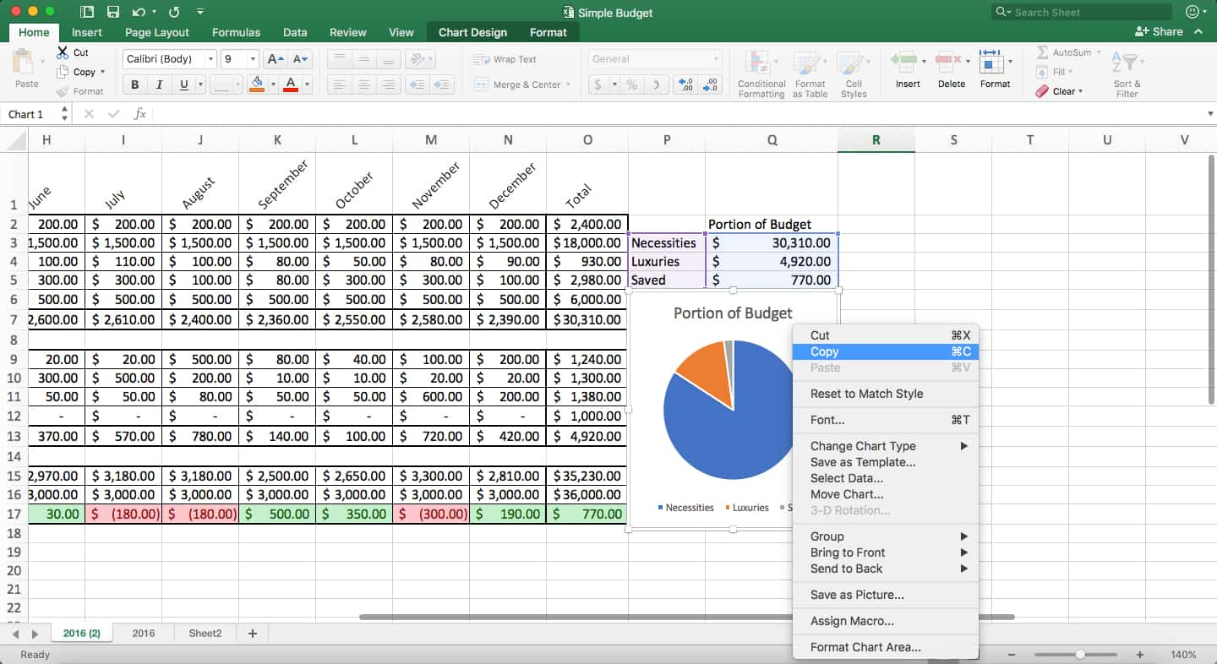
Storing 2D Data
Excel spreadsheet

Slide 8
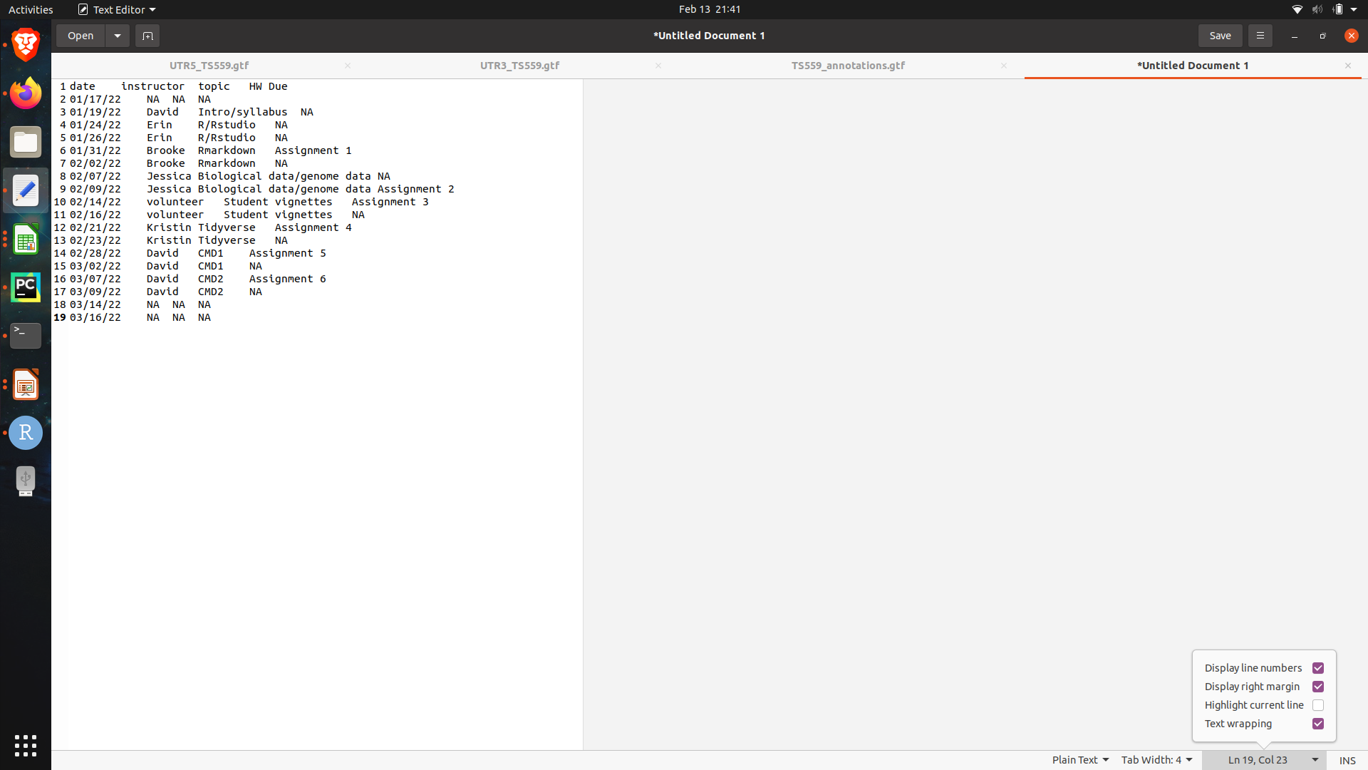
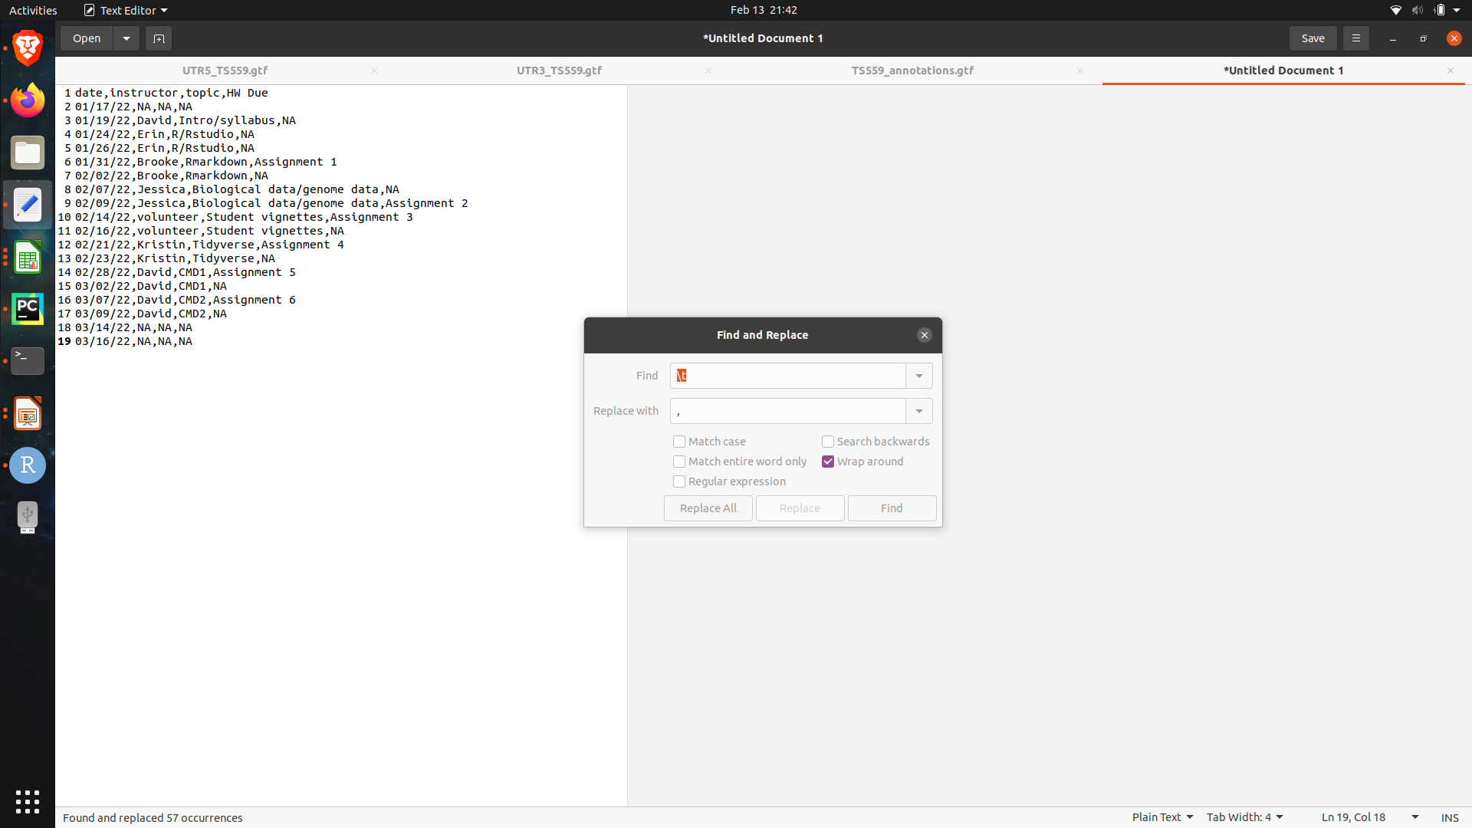
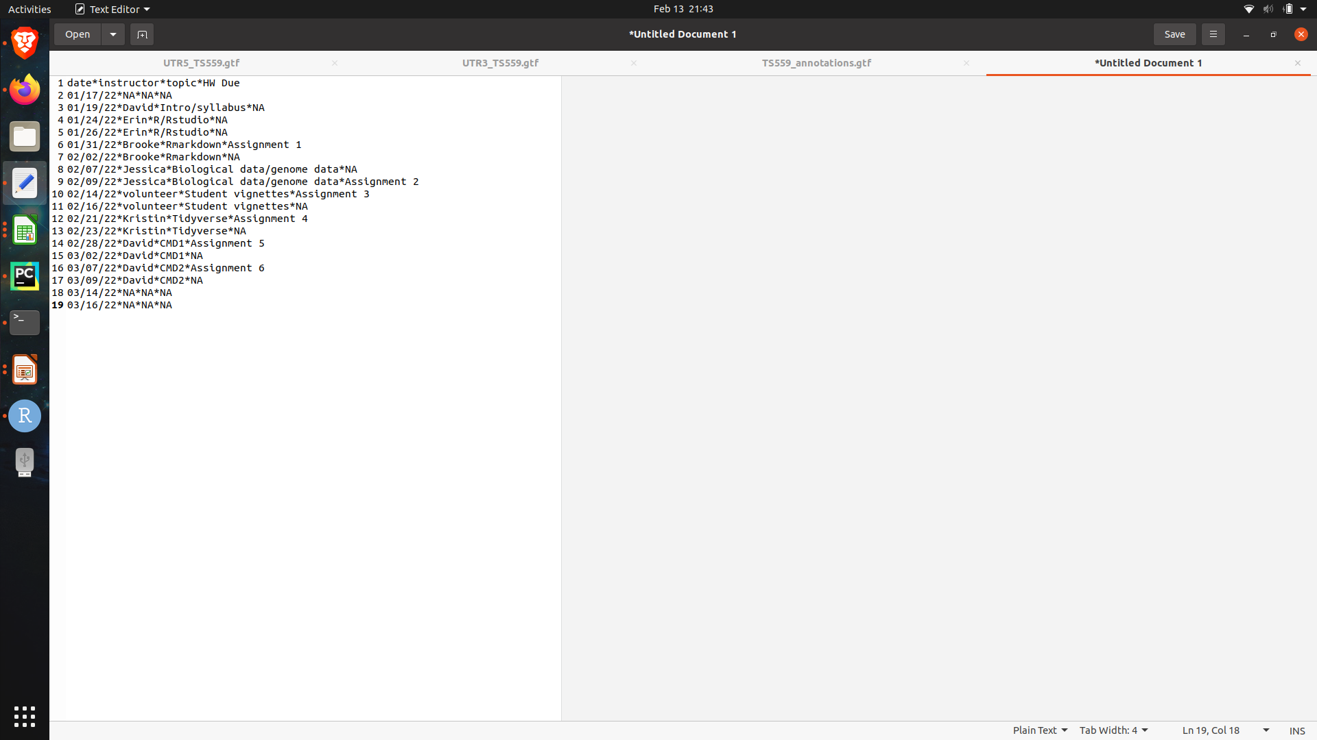
Storing 2D Data
Delimited text file
Tab separated (TSV)
Comma separated (CSV)
* separated

Slide 9
Manipulating Dataframes
Add/remove/modifying/retrieving data
Large data frames can be difficult to compute
Efficiency?
Accuracy?
Reproducible?
Transparent?

Slide 10

R is a programming language for statistical computing and graphics supported by the R Core Team and the R Foundation for Statistical Computing.
Created by statisticians Ross Ihaka and Robert Gentleman
R is used among data miners and statisticians for data analysis and developing statistical software

Slide 11
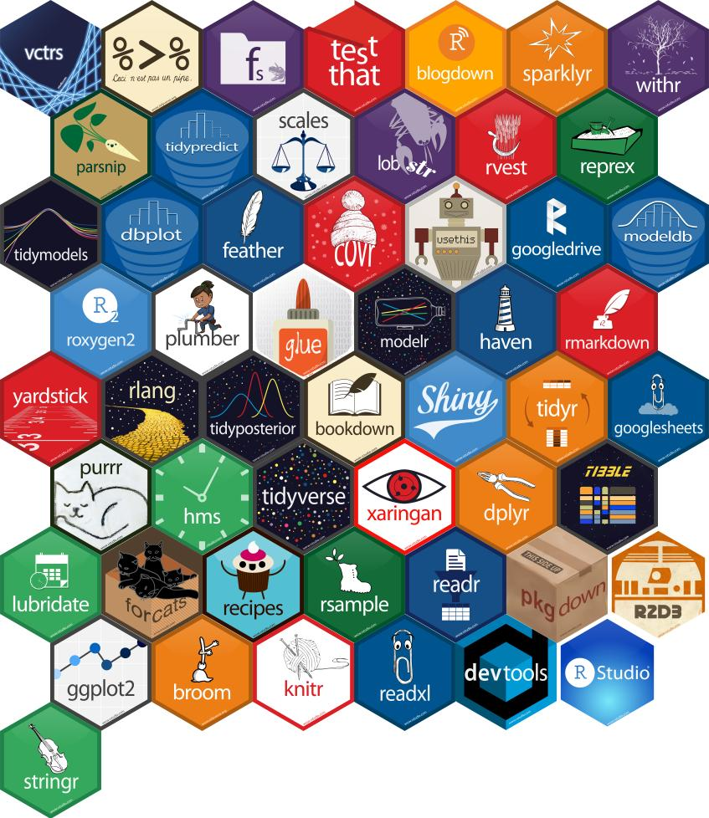

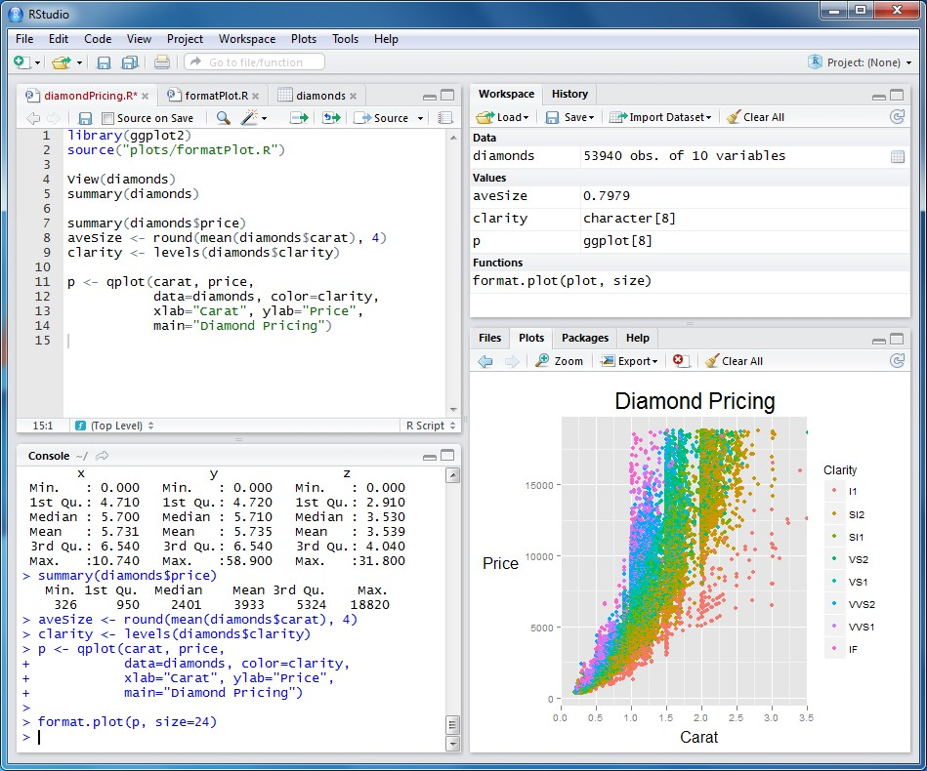

Slide 12
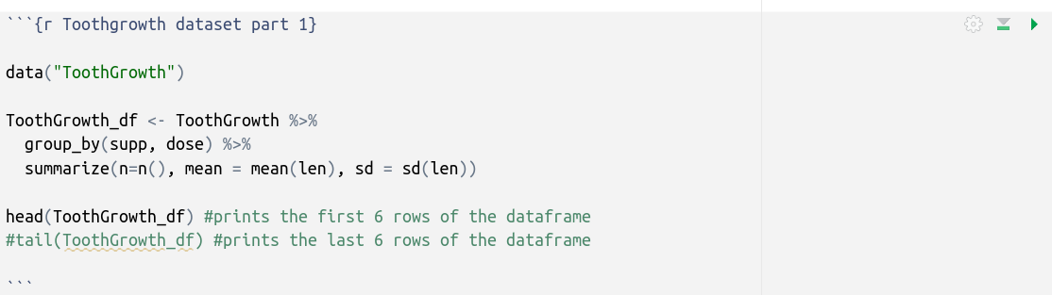
RMarkdown Quick Guide
A cell (or coding chunk) is denoted with three tick marks that open and close the cell (```)
At the top of the cell in curly brackets provides options to manipulate the output of the cell. The first argument is the name of the cell. You may learn about additional arguments later on in this course.
The green play button allows you run the code in the cell

Slide 13
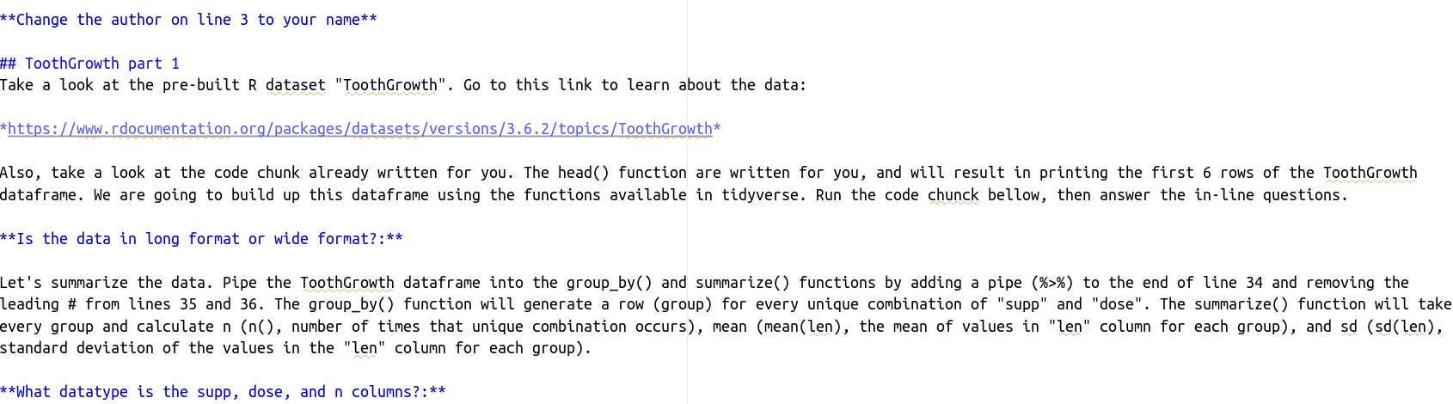
RMarkdown Quick Guide
There are many ways to make your RMarkdown document look pretty.
The hashes (#) and stars (*) are important. Please don’t remove them.

Slide 14
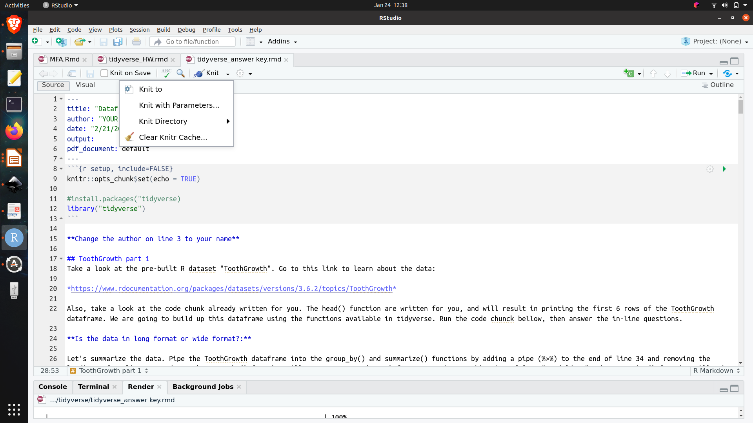
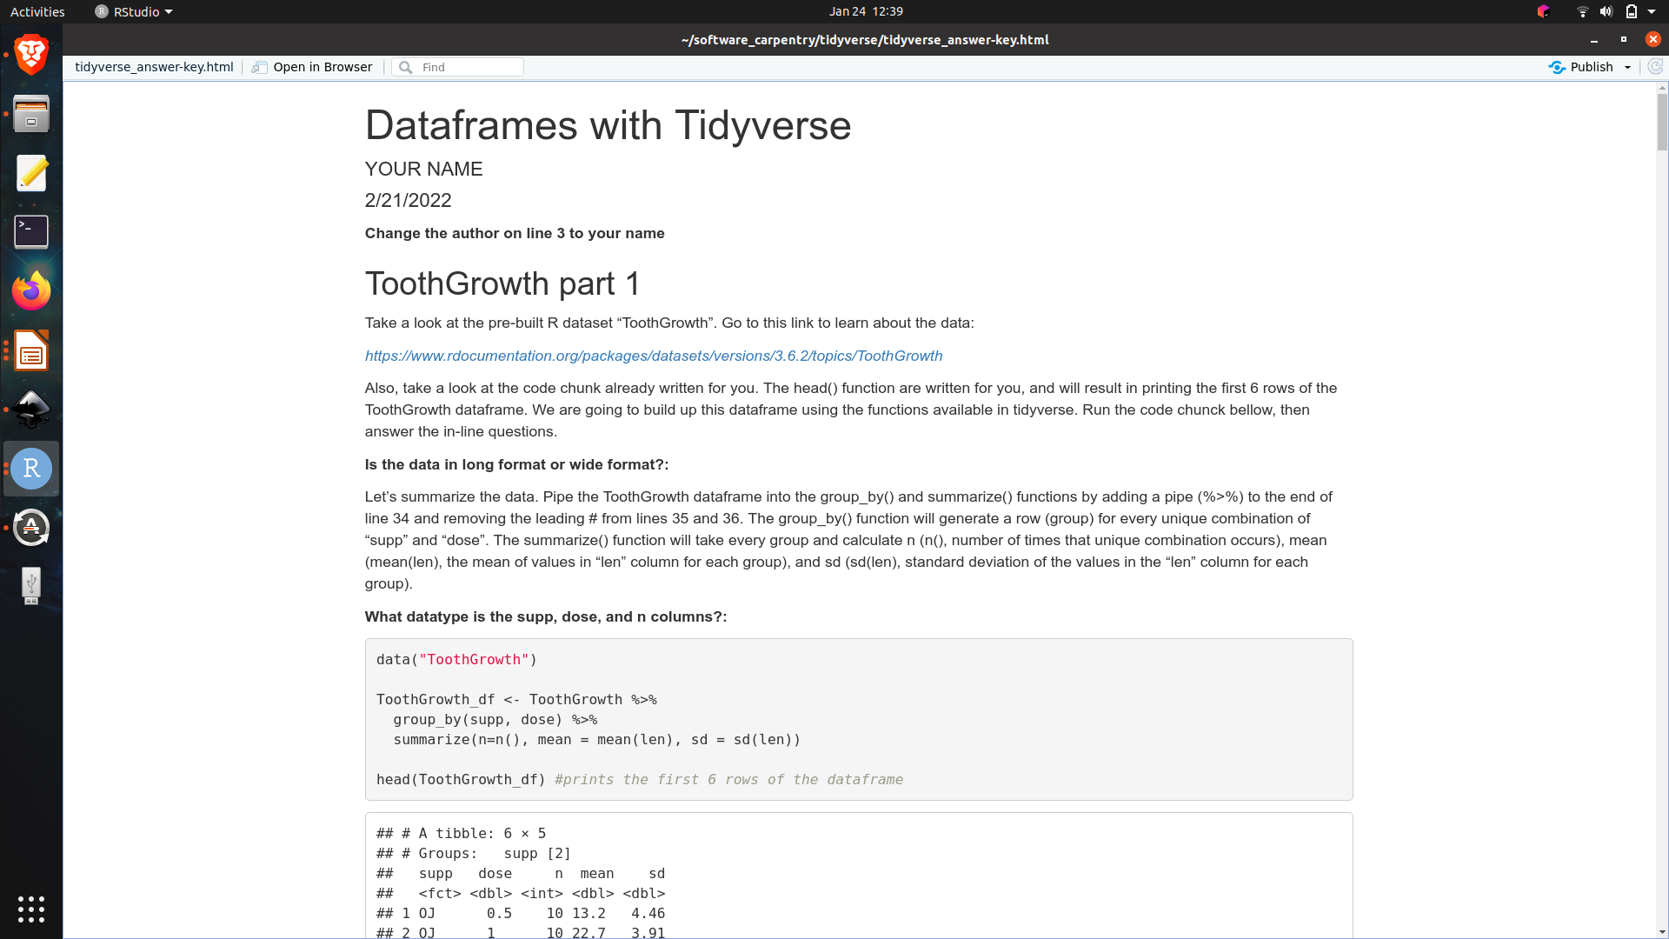
RMarkdown Quick Guide
When your assignment is complete, you will kit your document to a PDF.
Bugs in your code will prevent the document from knitting.

Slide 15

Data Frames
with

Slide 16
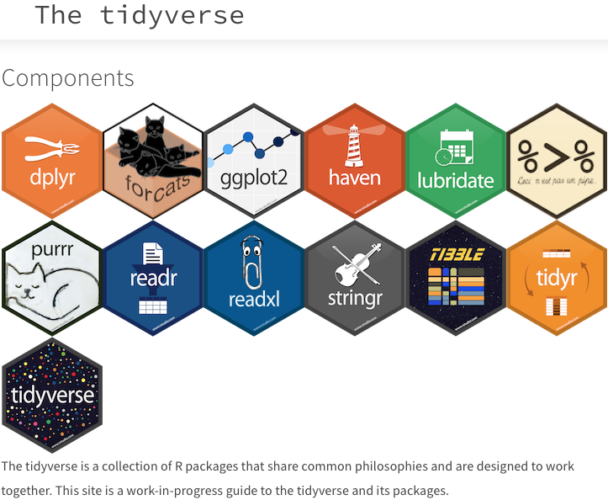
The tidyverse is a collection of R packages introduced by Hadley Wickham and his team that share an underlying design philosophy, grammar, and data structures of tidy data.

Slide 17
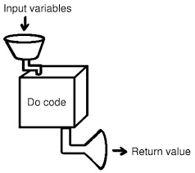
Functions
> function(argument1, argument2, ….)
[1] output
> my_list <- c(3,4,5,6)
> mean(my_list)
[1] 4.5

Slide 18
df <- read.delim(“path/to/df”, sep = “\t”)
> function(arg1 = df, arg2, arg3, ….)
[1] df # modified df with function applied
new_df <- df %>%

Slide 19
df <- read.delim(“path/to/df”, sep = “\t”)
> function(arg1 = df, arg2, arg3, ….)
[1] df # modified df with function applied
new_df <- df %>%
function(arg2, arg3, ...) %>%
function(arg2, arg3, …) %>%
function(arg2, arg3, …)

Slide 20
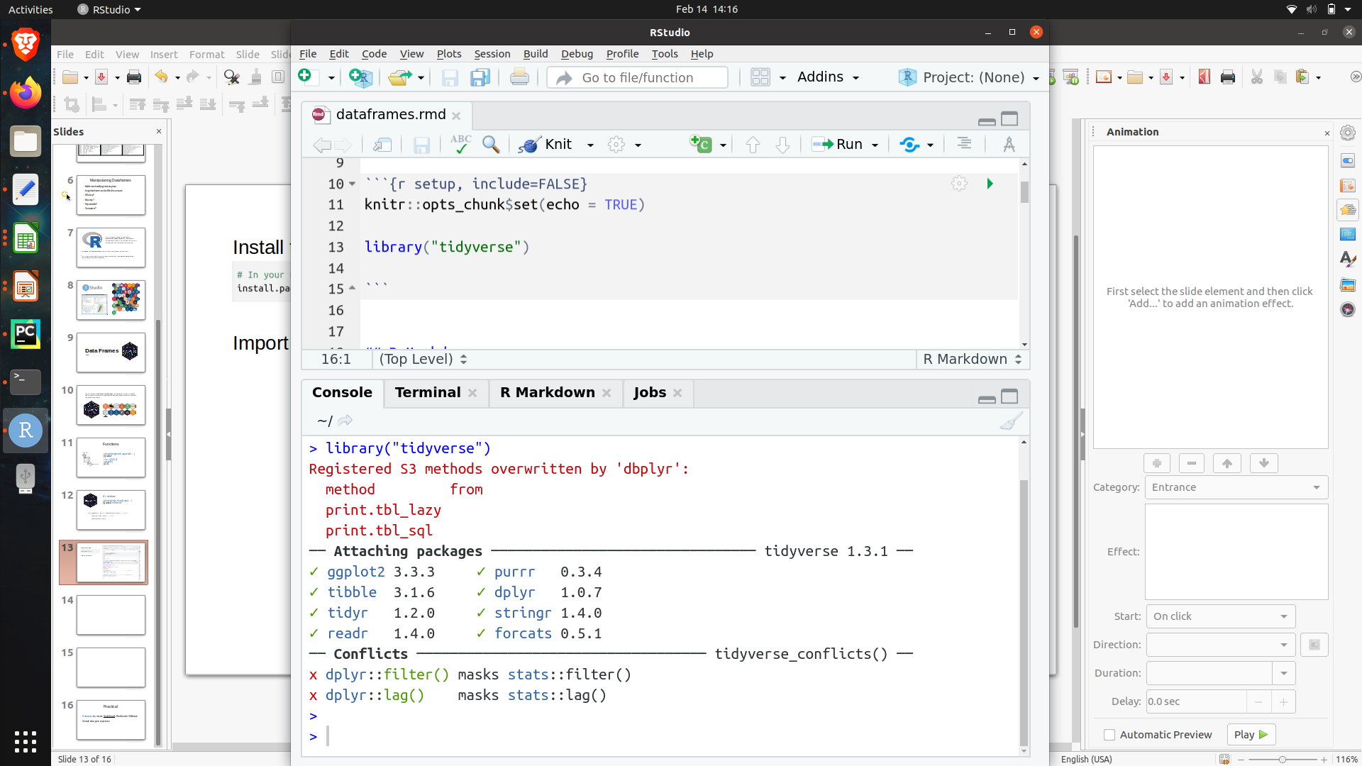
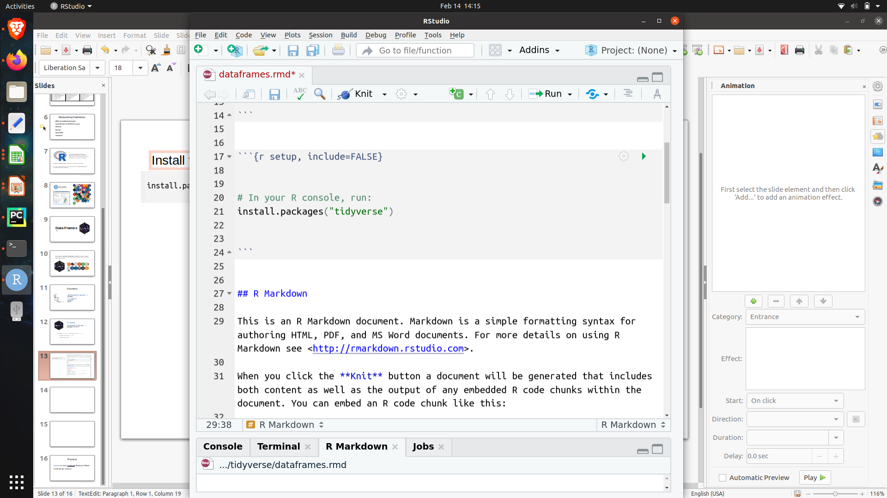
Install tidyverse:
Import tidyverse into your session
{
Tidyverse and associated pacakges are imported

Slide 21
Manipulations we will work on:
Mutate, select, rename, filter, merge, arrange, gather, spread
Other functions: grouping & summarizing, reading/writing data
Datatype conversions
At your discretion:
Data visualization with ggplot2

Slide 22
Tidyverse grammar
All functions take a dataframe as input
All functions produce a dataframe as output
It is therefore assumed that the first argument of a tidyverse function is always a dataframe
function(data = df, arg = <value> )
new_df <- df %>%
function(arg = <value> )

Slide 23
group_by / summarize
new_df <- df %>%
group_by(column1, column2, …) %>%
summarize(<formulas>)
new_df <- df_long %>%
group_by(group) %>%
summarize(n=n(),
mean = mean(observation),
sd = sd(observation) )
> df_long
> new_df
replicate | group | observation
1 | control | 12
2 | control | 11
3 | control | 14
1 | treamtment | 29
2 | treamtment | 21
3 | treamtment | 27
group | n | mean | sd
control | 3 | 12.33333 | 1.527525
treamtment | 3 | 25.66667 | 4.163332

Slide 24
<demo>

Slide 25
mutate (adding columns)
> df
mutate( df, new_column = <formula> )
replicate | control | treamtment
1 | 12 | 29
2 | 11 | 21
3 | 14 | 27
new_df <- df %>%
mutate( new_column = <formula> )
new_df <- df %>%
mutate( fold_change = treatment / control )
> new_df
replicate | control | treamtment | fold_change
1 | 12 | 29 | 2.4
2 | 11 | 21 | 1.91
3 | 14 | 27 | 1.92

Slide 26
mutate (adding columns)
> df
mutate( df, new_column = <formula> )
replicate | control | treamtment
1 | 12 | 29
2 | 11 | 21
3 | 14 | 27
new_df <- df %>%
mutate( new_column = <formula> )
new_df <- df %>%
mutate( fold_change = treatment / control )
> new_df
new_df <- df %>%
mutate( fold_change = treatment / control ) %>%
mutate( log2FC = log2(fold_change) )
replicate | control | treamtment | fold_change | log2FC
1 | 12 | 29 | 2.4 | 1.2
2 | 11 | 21 | 1.91 | 0.93
3 | 14 | 27 | 1.92 | 0.94

Slide 27
select (selecting/removing columns)
> df
select(df, column_name, -column_name)
replicate | control | treamtment | fold_change | log2FC
1 | 12 | 29 | 2.4 | 1.2
2 | 11 | 21 | 1.91 | 0.93
3 | 14 | 27 | 1.92 | 0.94
new_df <- df %>%
select(column_name, -column_name)
new_df <- df %>%
select(replicate, control, treatment, fold_change)
> new_df
replicate | control | treamtment | fold_change
1 | 12 | 29 | 2.4
2 | 11 | 21 | 1.91
3 | 14 | 27 | 1.92
OR...
new_df <- df %>%
select(-log2FC)
select() can also be used to re-order columns

Slide 28
rename (renaming columns)
dplyr::rename(df, new_column_name=old_column_name)
> df
replicate | control | treamtment | fold_change
1 | 12 | 29 | 2.4
2 | 11 | 21 | 1.91
3 | 14 | 27 | 1.92
new_df <- df %>%
dplyr::rename(new_name = old_name)
new_df <- df %>%
dplyr::rename(FC = fold_change)
> new_df
replicate | control | treamtment | FC
1 | 12 | 29 | 2.4
2 | 11 | 21 | 1.91
3 | 14 | 27 | 1.92

Slide 29
arrange
new_df <- df %>%
filter(log2FC > 1 | log2FC < -1) %>%
filter(pvalue < 0.05) %>%
merge(y=df2, by= “gene”, all.x=TRUE)
arrange(df, column_name)
arrange(df, desc(column_name) )
> new_df
arrange(df, -column_name)
gene | RPKM control | RPKM treatment | fold change | log2FC | pvalue | symbol | description
gene5 | 32 | 10 | 0.31 | -1.68 | 0.02 | GAGE12F | G antigen 12F
gene7 | 12 | 1 | 0.08 | -3.58 | 0.001 | NAALAD2 | N-acetylated acidic dipeptidase 2
gene10 | 19 | 70 | 3.68 | 1.88 | 0.011 | ZBTB33 | zinc finger and BTB domain containing 33
new_df <- df %>%
arrange(column_name )

Slide 30
arrange
new_df <- df %>%
filter(log2FC > 1 | log2FC < -1) %>%
filter(pvalue < 0.05) %>%
merge(y=df2, by= “gene”, all.x=TRUE) %>%
arrange(pvalue)
arrange(df, column_name)
arrange(df, desc(column_name) )
> new_df
arrange(df, -column_name)
gene | RPKM control | RPKM treatment | fold change | log2FC | pvalue | symbol | description
gene7 | 12 | 1 | 0.08 | -3.58 | 0.001 | NAALAD2 | N-acetylated acidic dipeptidase 2
gene10 | 19 | 70 | 3.68 | 1.88 | 0.011 | ZBTB33 | zinc finger and BTB domain containing 33
gene5 | 32 | 10 | 0.31 | -1.68 | 0.02 | GAGE12F | G antigen 12F
new_df <- df %>%
arrange(column_name )

Slide 31
<demo>

Slide 32
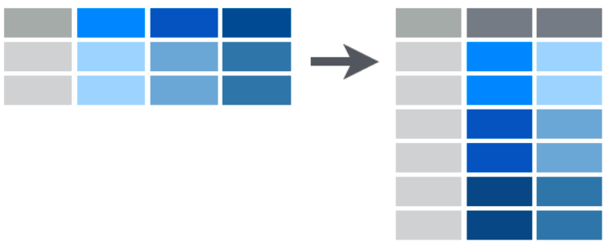
gather (melt)
df_long <- df_wide %>%
gather(key= “group”,
value = “observation”, 2:3)
Wide form→ long form
> df_long
replicate | group | observation
1 | control | 12
2 | control | 11
3 | control | 14
1 | treamtment | 29
2 | treamtment | 21
3 | treamtment | 27
new_df <- df %>%
gather(key = <column_name>,
value = <column_name>, <column_range>)
> df_wide
replicate | control | treamtment
1 | 12 | 29
2 | 11 | 21
3 | 14 | 27

Slide 33
spread (pivot)
df_wide <- df_long %>%
spread(key = “group”,
value = “observation”)
Long form→ wide form
> df_wide
replicate | control | treamtment
1 | 12 | 29
2 | 11 | 21
3 | 14 | 27
df_wide <- df_long %>%
spread(key = <column_name>,
value = <column_name>)
> df_long
replicate | group | observation
1 | control | 12
2 | control | 11
3 | control | 14
1 | treamtment | 29
2 | treamtment | 21
3 | treamtment | 27

Slide 34
<demo>

Slide 35
filter (select rows based on value)
filter(df, column_name <operation> <formula>)
new_df <- df %>%
filter( column_name <operation> <formula> )
Operations:
==, !=, >, <
&, |

Slide 36
new_df <- df %>%
filter(log2FC > 1 | log2FC < -1)
> df
> new_df
gene | RPKM control | RPKM treatment | fold change | log2FC | pvalue
gene1 | 15 | 14 | 0.93 | -0.10 | 0.95
gene2 | 2 | 5 | 2.50 | 1.32 | 0.68
gene3 | 4 | 7 | 1.75 | 0.81 | 0.45
gene4 | 6 | 10 | 1.67 | 0.74 | 0.79
gene5 | 32 | 10 | 0.31 | -1.68 | 0.02
gene6 | 45 | 56 | 1.24 | 0.32 | 0.55
gene7 | 12 | 1 | 0.08 | -3.58 | 0.001
gene8 | 65 | 57 | 0.88 | -0.19 | 0.37
gene9 | 12 | 12 | 1.00 | 0.00 | 1
gene10 | 19 | 70 | 3.68 | 1.88 | 0.011
gene | RPKM control | RPKM treatment | fold change | log2FC | pvalue
gene2 | 2 | 5 | 2.50 | 1.32 | 0.68
gene5 | 32 | 10 | 0.31 | -1.68 | 0.02
gene7 | 12 | 1 | 0.08 | -3.58 | 0.001
gene10 | 19 | 70 | 3.68 | 1.88 | 0.011
> new_df

Slide 37
new_df <- df %>%
filter(log2FC > 1 | log2FC < -1) %>%
filter(pvalue < 0.05)
> df
OR...
gene | RPKM control | RPKM treatment | fold change | log2FC | pvalue
gene1 | 15 | 14 | 0.93 | -0.10 | 0.95
gene2 | 2 | 5 | 2.50 | 1.32 | 0.68
gene3 | 4 | 7 | 1.75 | 0.81 | 0.45
gene4 | 6 | 10 | 1.67 | 0.74 | 0.79
gene5 | 32 | 10 | 0.31 | -1.68 | 0.02
gene6 | 45 | 56 | 1.24 | 0.32 | 0.55
gene7 | 12 | 1 | 0.08 | -3.58 | 0.001
gene8 | 65 | 57 | 0.88 | -0.19 | 0.37
gene9 | 12 | 12 | 1.00 | 0.00 | 1
gene10 | 19 | 70 | 3.68 | 1.88 | 0.011
new_df <- df %>%
filter( (log2FC > 1 | log2FC < -1) & pvalue < 0.05)
> new_df
> new_df
gene | RPKM control | RPKM treatment | fold change | log2FC | pvalue
gene5 | 32 | 10 | 0.31 | -1.68 | 0.02
gene7 | 12 | 1 | 0.08 | -3.58 | 0.001
gene10 | 19 | 70 | 3.68 | 1.88 | 0.011

Slide 38
new_df <- df %>%
filter( gene == “gene1” )
new_df <- df %>%
filter( gene != “gene1” )
> new_df
> new_df
gene | RPKM control | RPKM treatment | fold change | log2FC | pvalue
gene1 | 15 | 14 | 0.93 | -0.10 | 0.95
gene | RPKM control | RPKM treatment | fold change | log2FC | pvalue
gene2 | 2 | 5 | 2.50 | 1.32 | 0.68
gene3 | 4 | 7 | 1.75 | 0.81 | 0.45
gene4 | 6 | 10 | 1.67 | 0.74 | 0.79
gene5 | 32 | 10 | 0.31 | -1.68 | 0.02
gene6 | 45 | 56 | 1.24 | 0.32 | 0.55
gene7 | 12 | 1 | 0.08 | -3.58 | 0.001
gene8 | 65 | 57 | 0.88 | -0.19 | 0.37
gene9 | 12 | 12 | 1.00 | 0.00 | 1
gene10 | 19 | 70 | 3.68 | 1.88 | 0.011

Slide 39
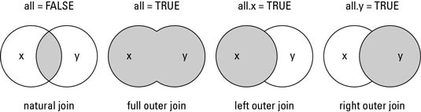
merge dataframes
merge(x = df.x, y = df.y, by = c(“column_name”), all.x = TRUE)
all.y = TRUE
all = TRUE
all = FALSE

Slide 40
new_df <- df %>%
filter(log2FC > 1 | log2FC < -1) %>%
filter(pvalue < 0.05)
new_df <- df %>%
filter(log2FC > 1 | log2FC < -1) %>%
filter(pvalue < 0.05) %>%
merge(y=df2, by= “gene”, all.x=TRUE)
> new_df
gene | RPKM control | RPKM treatment | fold change | log2FC | pvalue
gene5 | 32 | 10 | 0.31 | -1.68 | 0.02
gene7 | 12 | 1 | 0.08 | -3.58 | 0.001
gene10 | 19 | 70 | 3.68 | 1.88 | 0.011
> new_df
gene | RPKM control | RPKM treatment | fold change | log2FC | pvalue | symbol | description
gene5 | 32 | 10 | 0.31 | -1.68 | 0.02 | GAGE12F | G antigen 12F
gene7 | 12 | 1 | 0.08 | -3.58 | 0.001 | NAALAD2 | N-acetylated acidic dipeptidase 2
gene10 | 19 | 70 | 3.68 | 1.88 | 0.011 | ZBTB33 | zinc finger and BTB domain containing 33
> df2
gene | symbol | description
gene1 | A1BG | alpha-1-B glycoprotein
gene2 | NAT2 | N-acetyltransferase 2
gene3 | ADA | adenosine deaminase
gene4 | CDH2 | cadherin 2
gene5 | GAGE12F | G antigen 12F
gene6 | MED6 | mediator complex subunit 6
gene7 | NAALAD2 | N-acetylated acidic dipeptidase 2
gene8 | DUXB | double homeobox B
gene9 | DDTL | D-dopachrome tautomerase like
gene10 | ZBTB33 | zinc finger and BTB domain containing 33

Slide 41
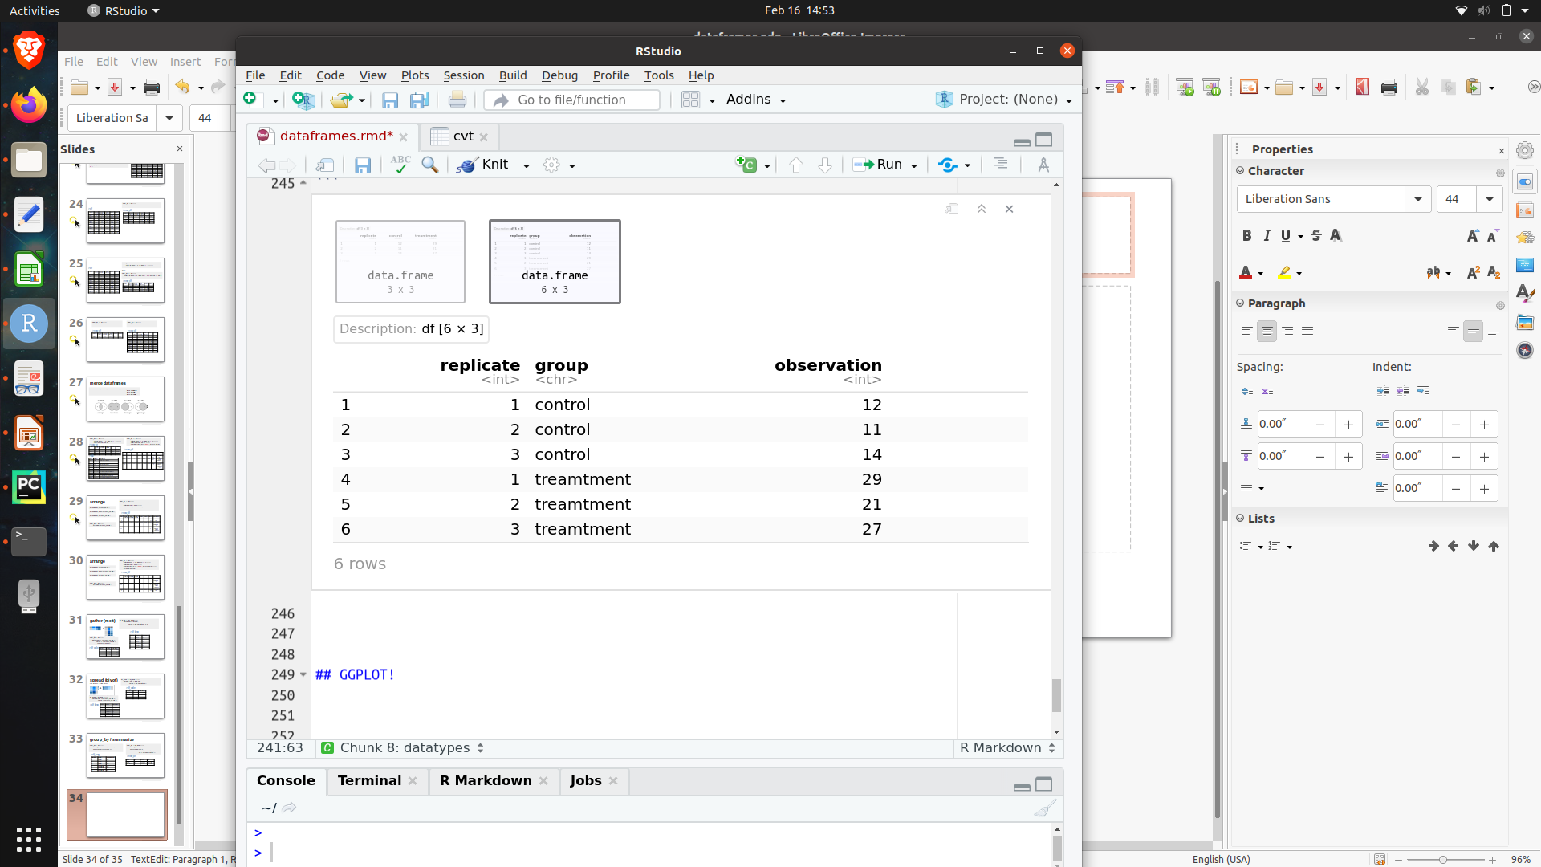
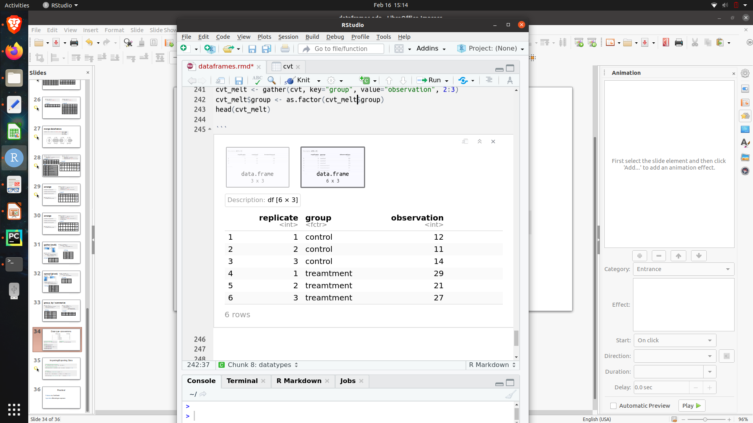
Data type conversions
replicate | group | observation
1 | control | 12
2 | control | 11
3 | control | 14
1 | treamtment | 29
2 | treamtment | 21
3 | treamtment | 27
=
# to convert data types:
df$column <- as.<type>(df$column)
# Examples
df$group <- as.factor(df$group)
#options:
as.character(df$column)
as.factor(df$column);
factor(df$column, levels=c(...) )
as.integer(df$column)
as.double(df$column)

Slide 42
Importing/Exporting Data
# Importing dataframe from text file
df <- read.delim( <path_to_data>, sep = <delimiter> )
# Exporting dataframe to text file
write.table(df, <path_to_destination>, sep = <delimiter>, row.name=FALSE)
# Example
df <- read.delim(“./project/DGE.tsv”, sep = “\t” )
new_df <- df %>% filter( (log2FC > 1 | log2FC < -1) & pvalue < 0.05)
write.table(new_df, “./DGE_analysis.csv”, sep = “,” , row.name = FALSE)

Slide 43

Data Visualization
with
*This section is optional and self-taught

Slide 44
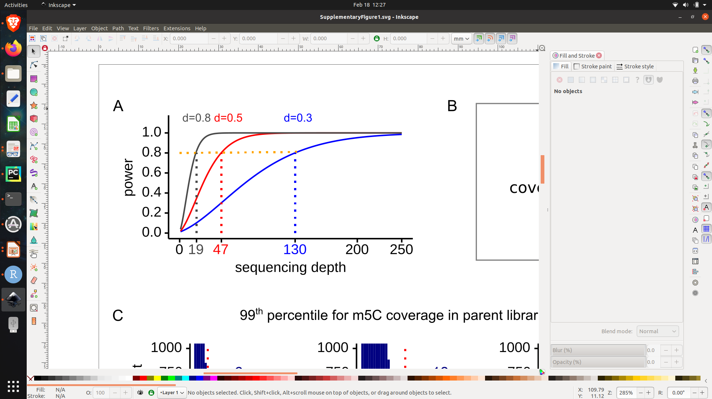
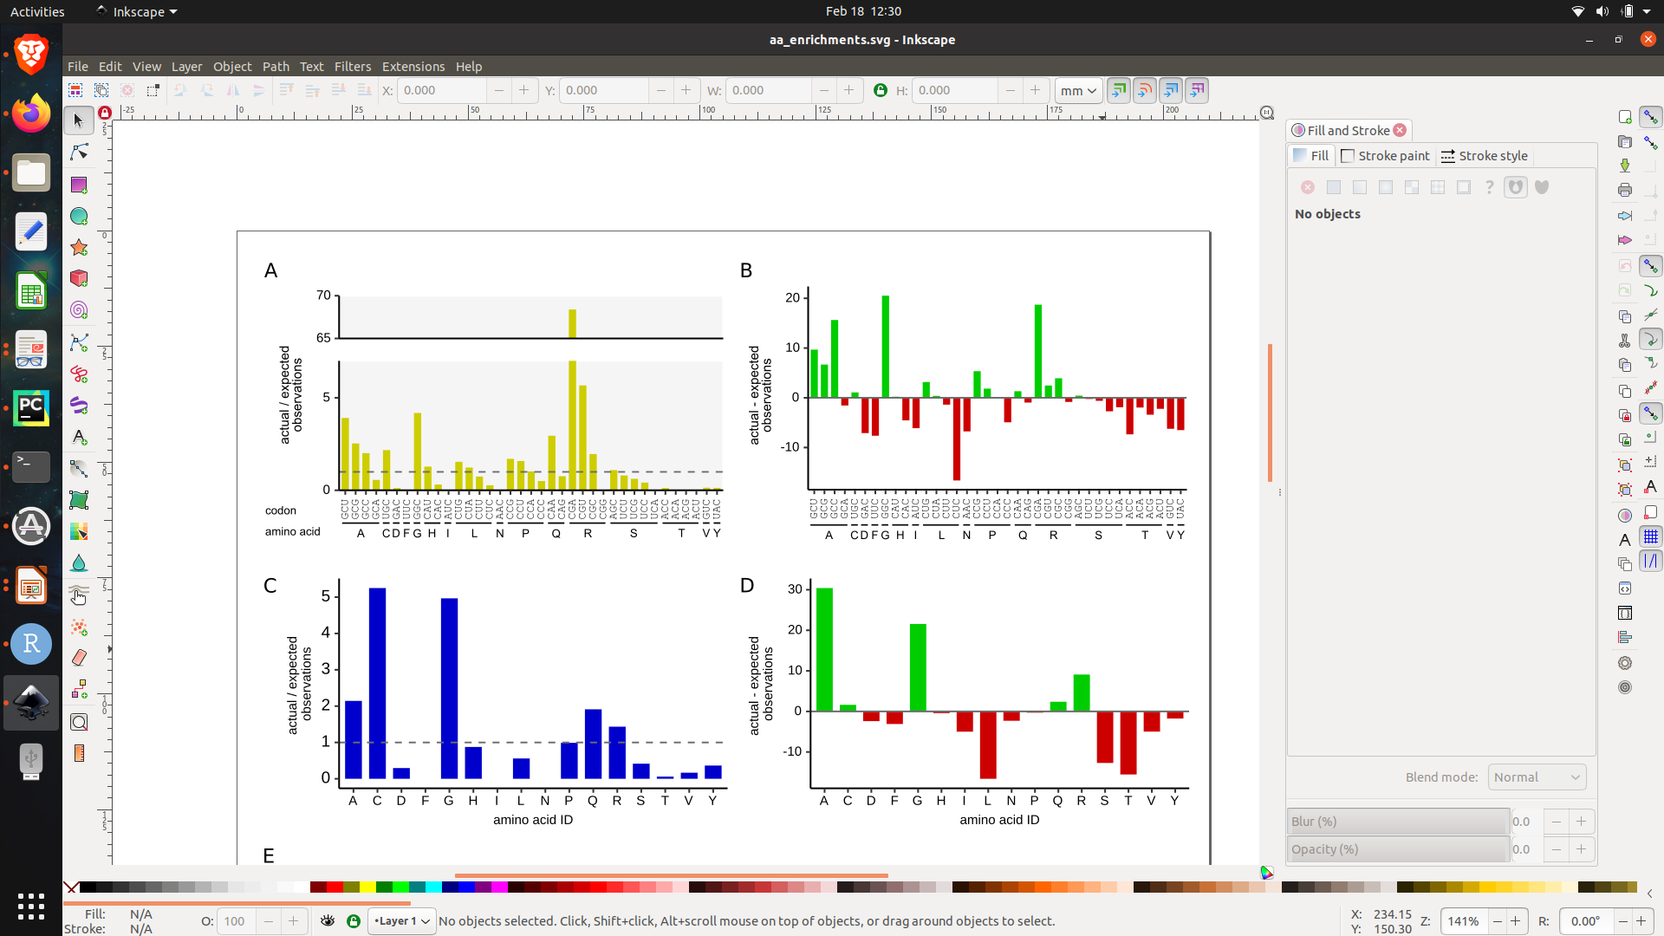
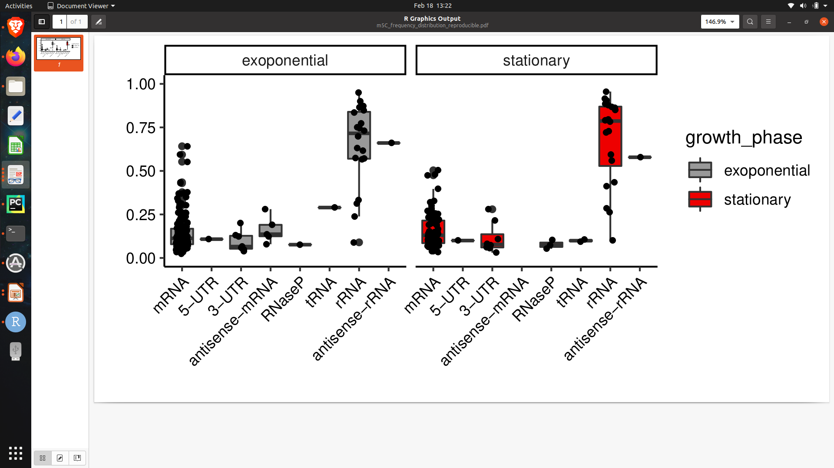
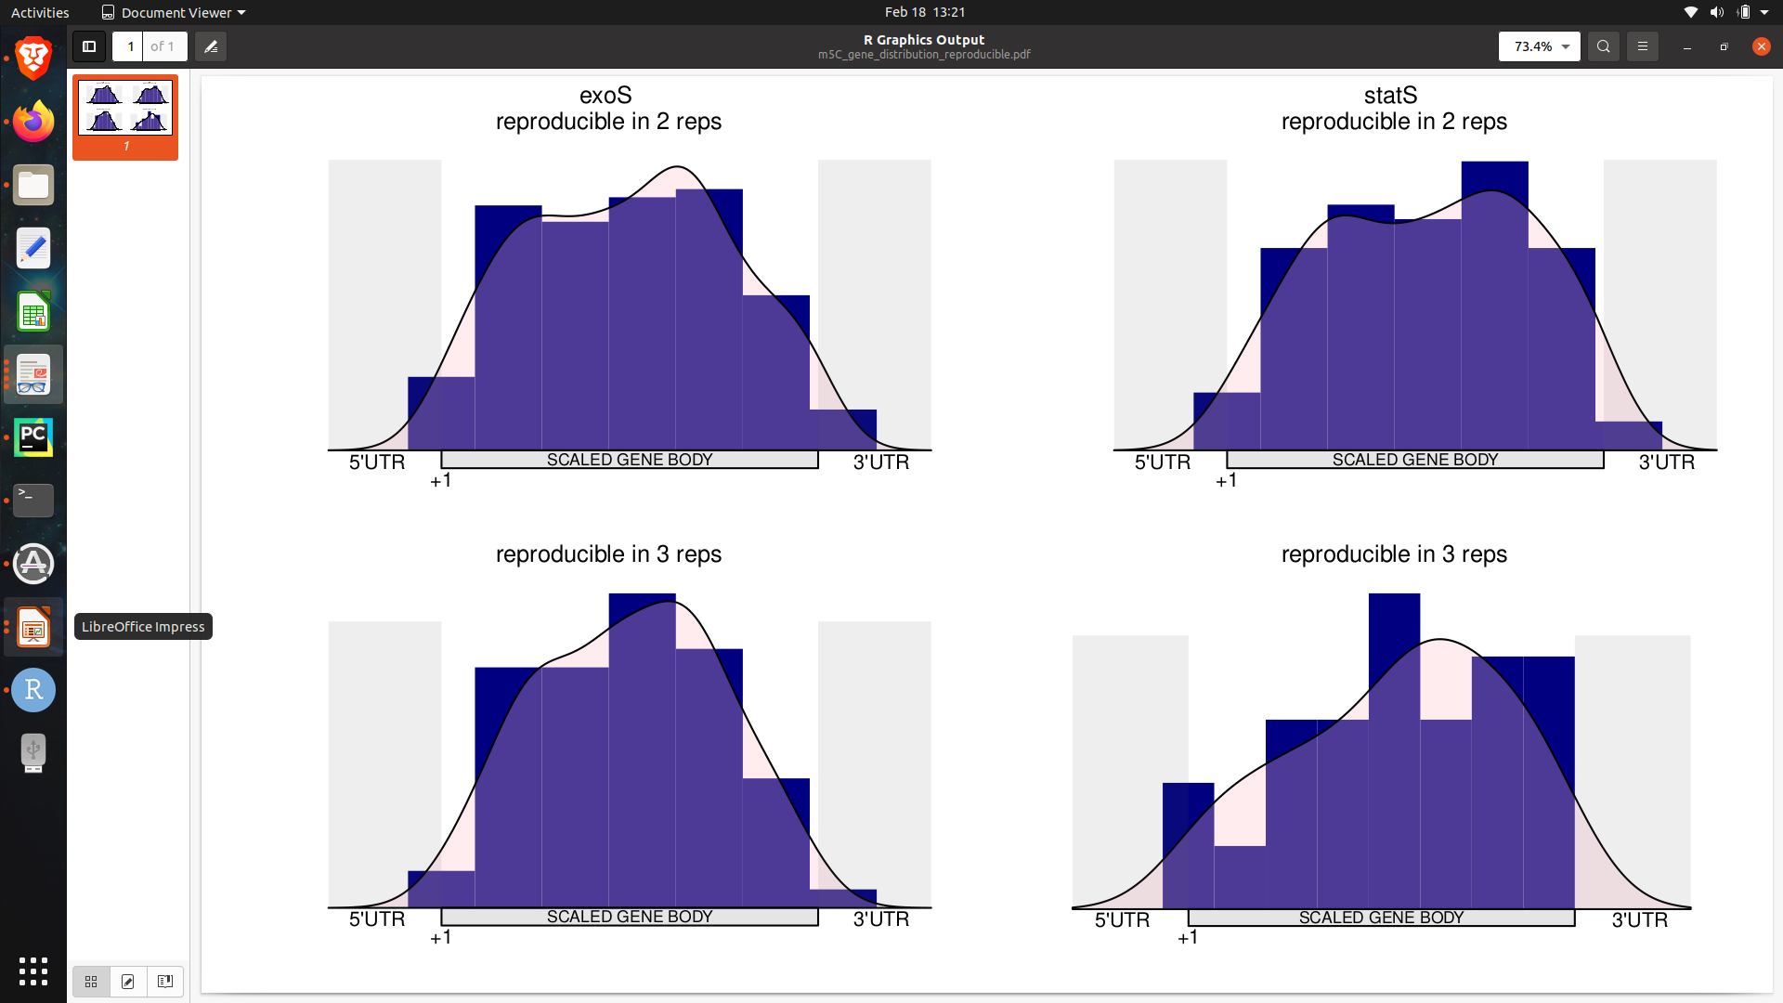
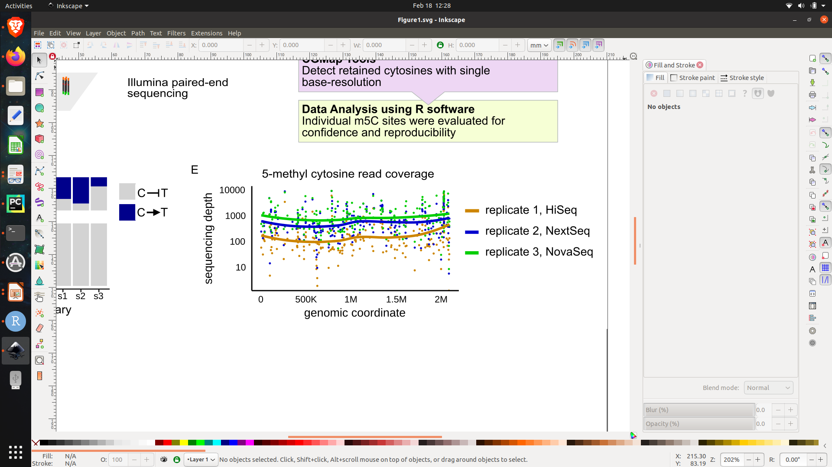
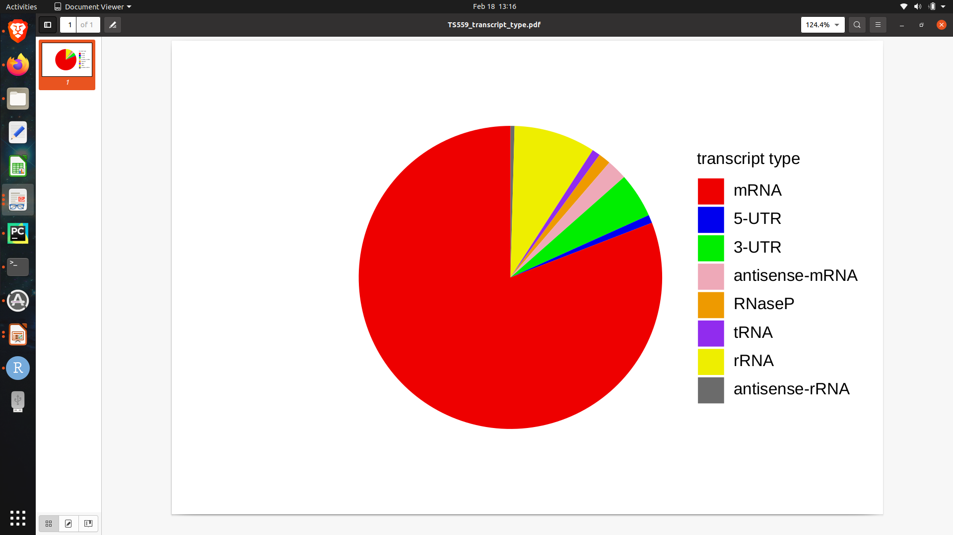
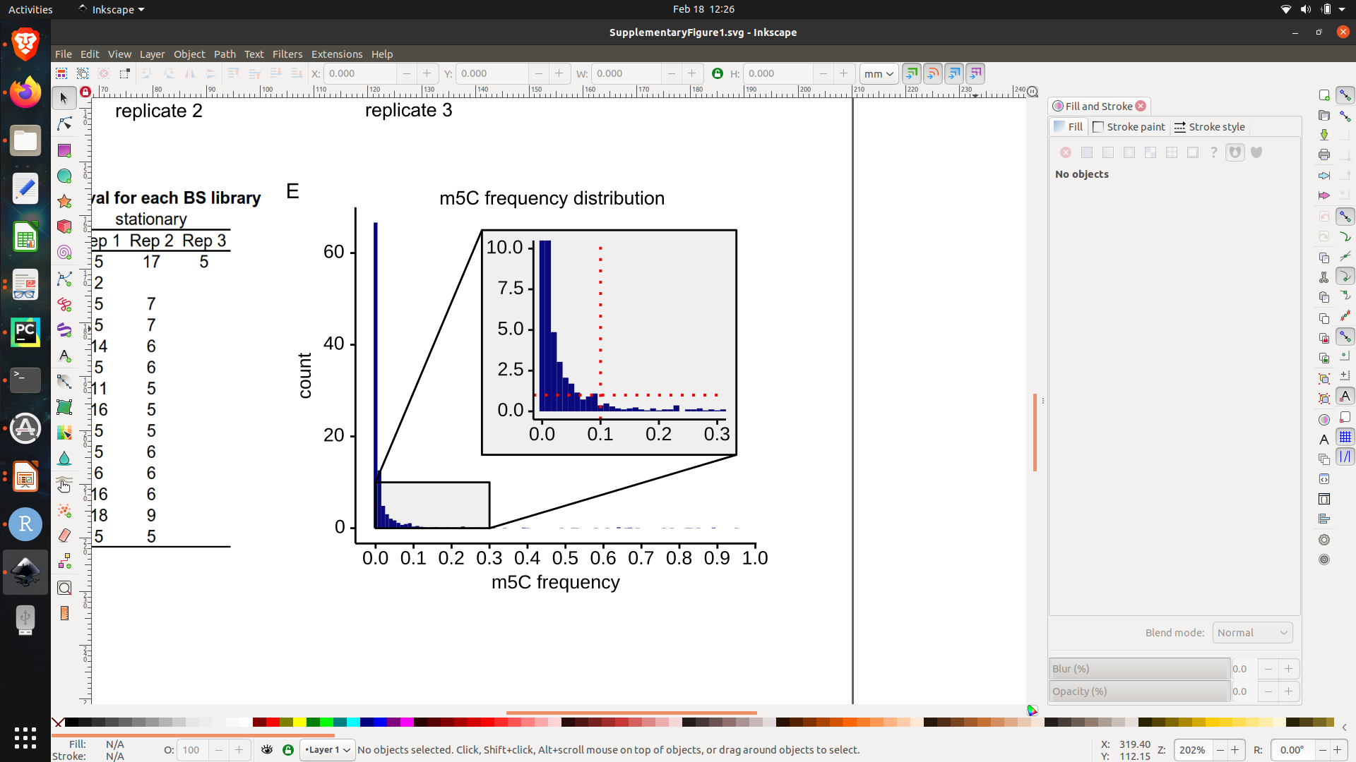
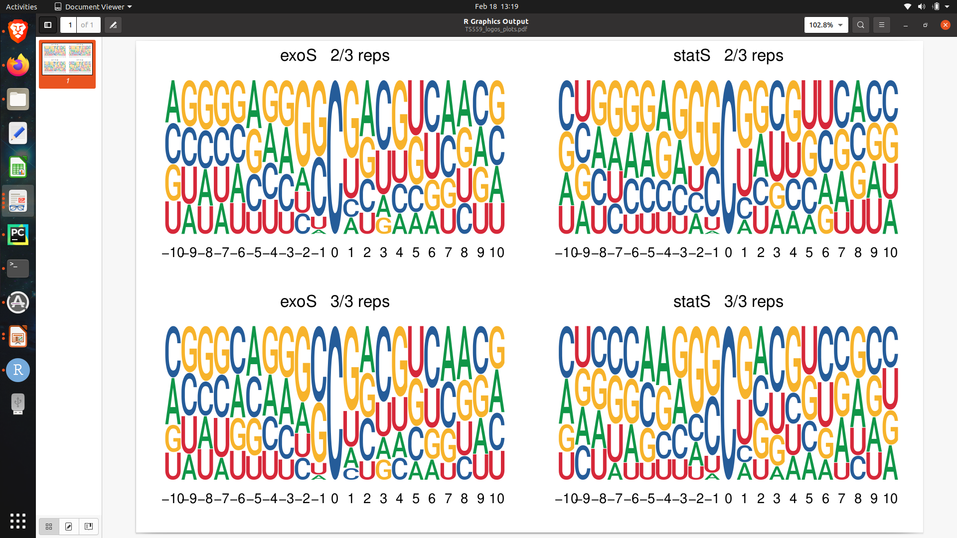
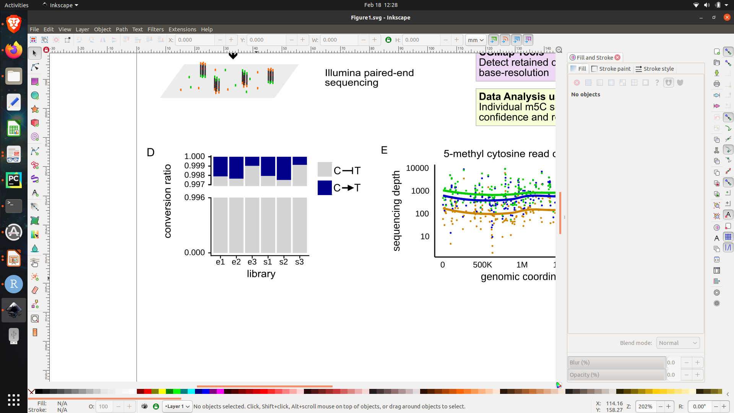
Some of my own ggplots

Slide 45

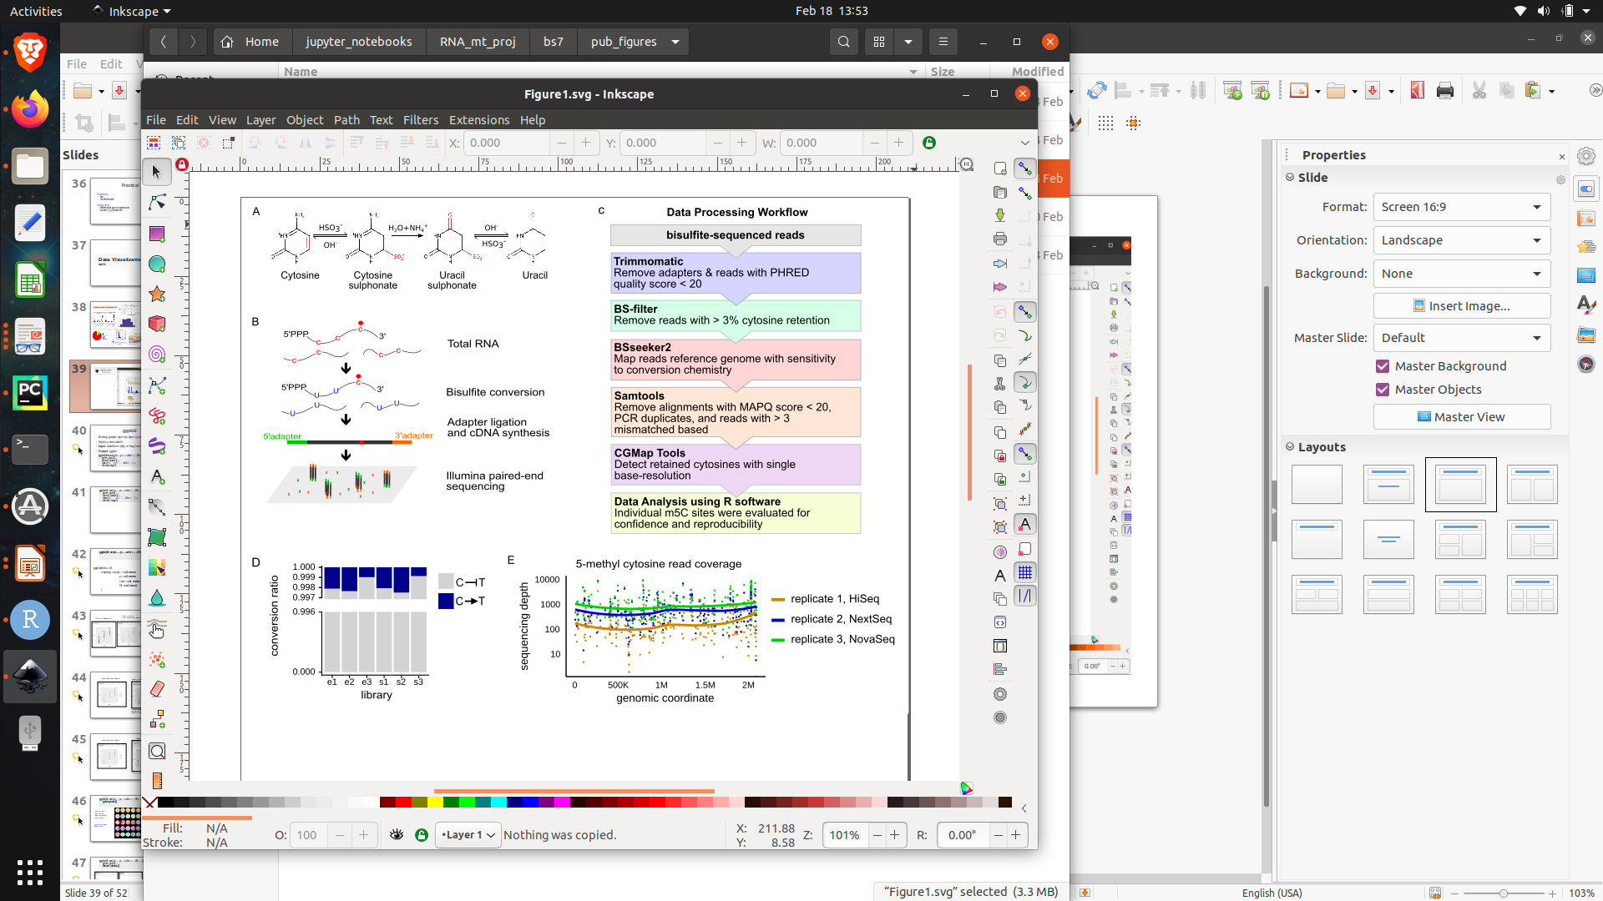
Free, open source graphics design platform
Similar to photoshop and adobe illustrator
Allows you to arrange and edit figures
Saved ggplot images can be imported into inkscape and easily edited

Slide 46
ggplot2
Building graphs layer-by-layer
piping operator: +
Input: dataframe (tidy or long format)
Output: ggplot
ggplot(data, aes(x=…, y=…, color = …, fill = …)) +
geom_point() +
theme_classic() +
labs(x = “…”, y = “…” , title = “...”) +
theme(<args>)

Slide 47
ggplot(df, aes(x=…, y=…, color = …, fill = …))
ggplot(data = df,
mapping = aes(x = col_name,
y = col_name,
color = col_name,
fill = col_name)
)
Fill
Color

Slide 48
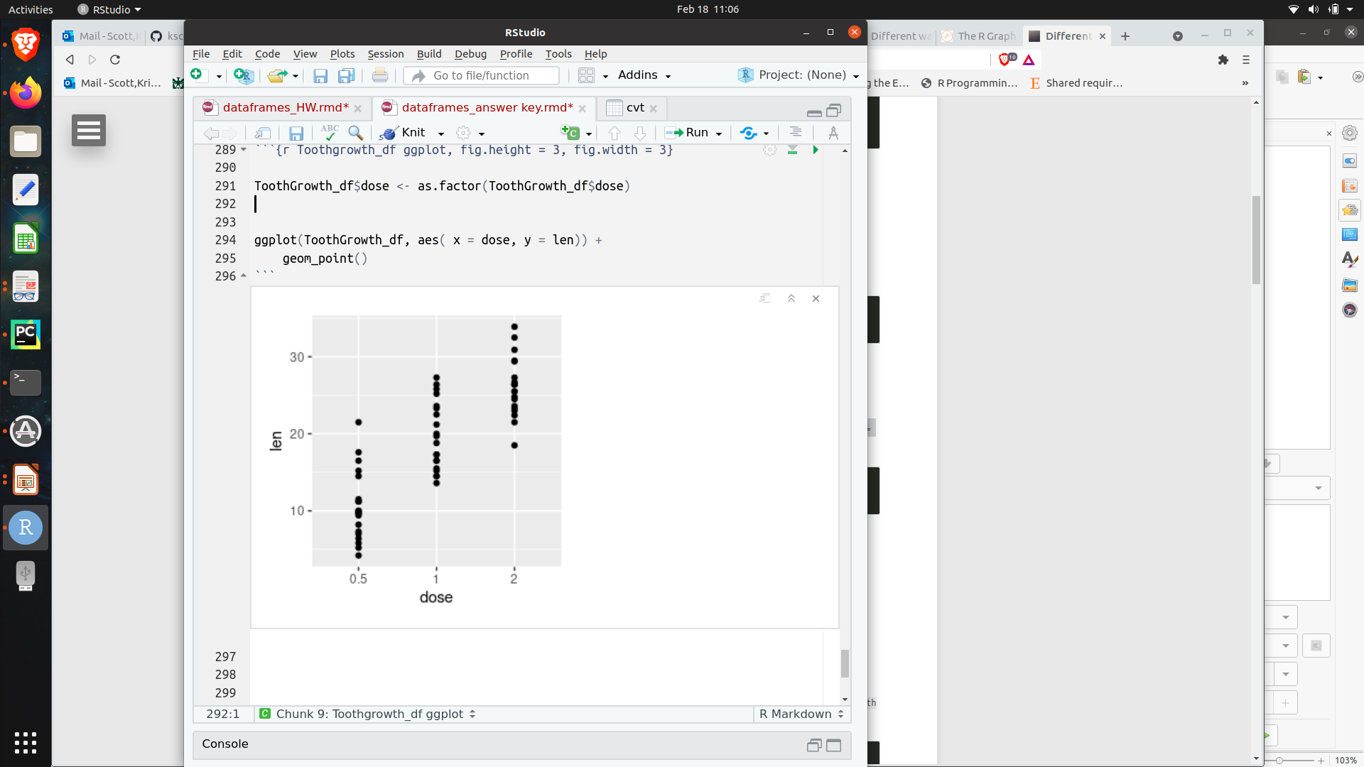
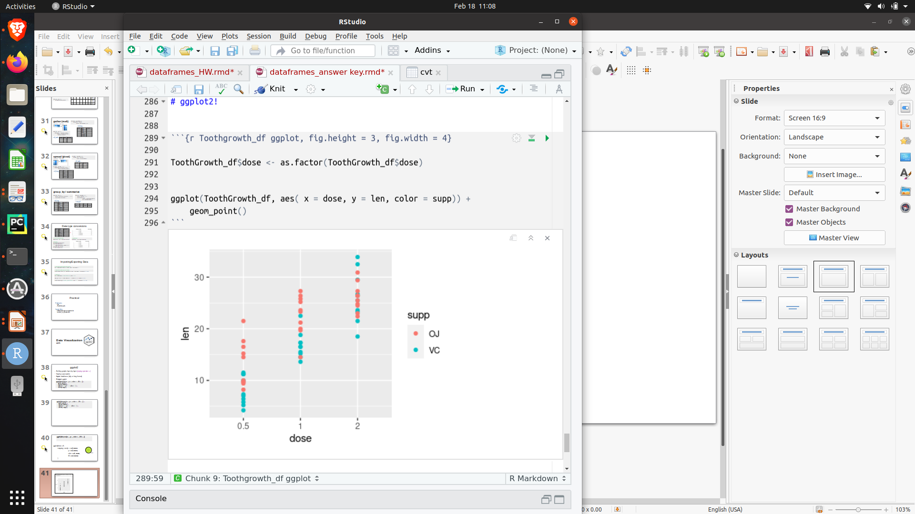
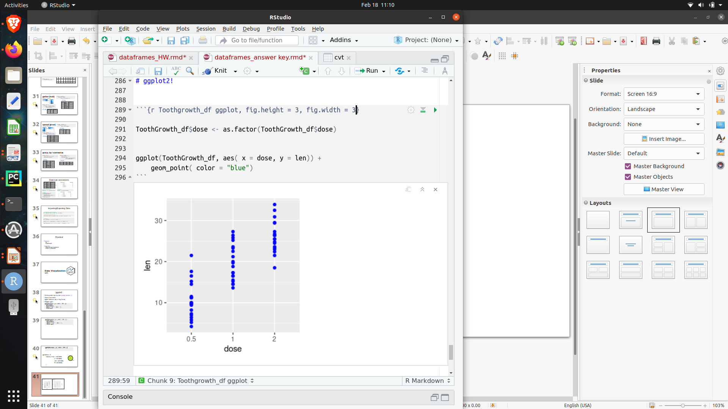
Color by group:
Color assigned in aes()
Color all data points:
Color assigned in geom()
No color assignment

Slide 49
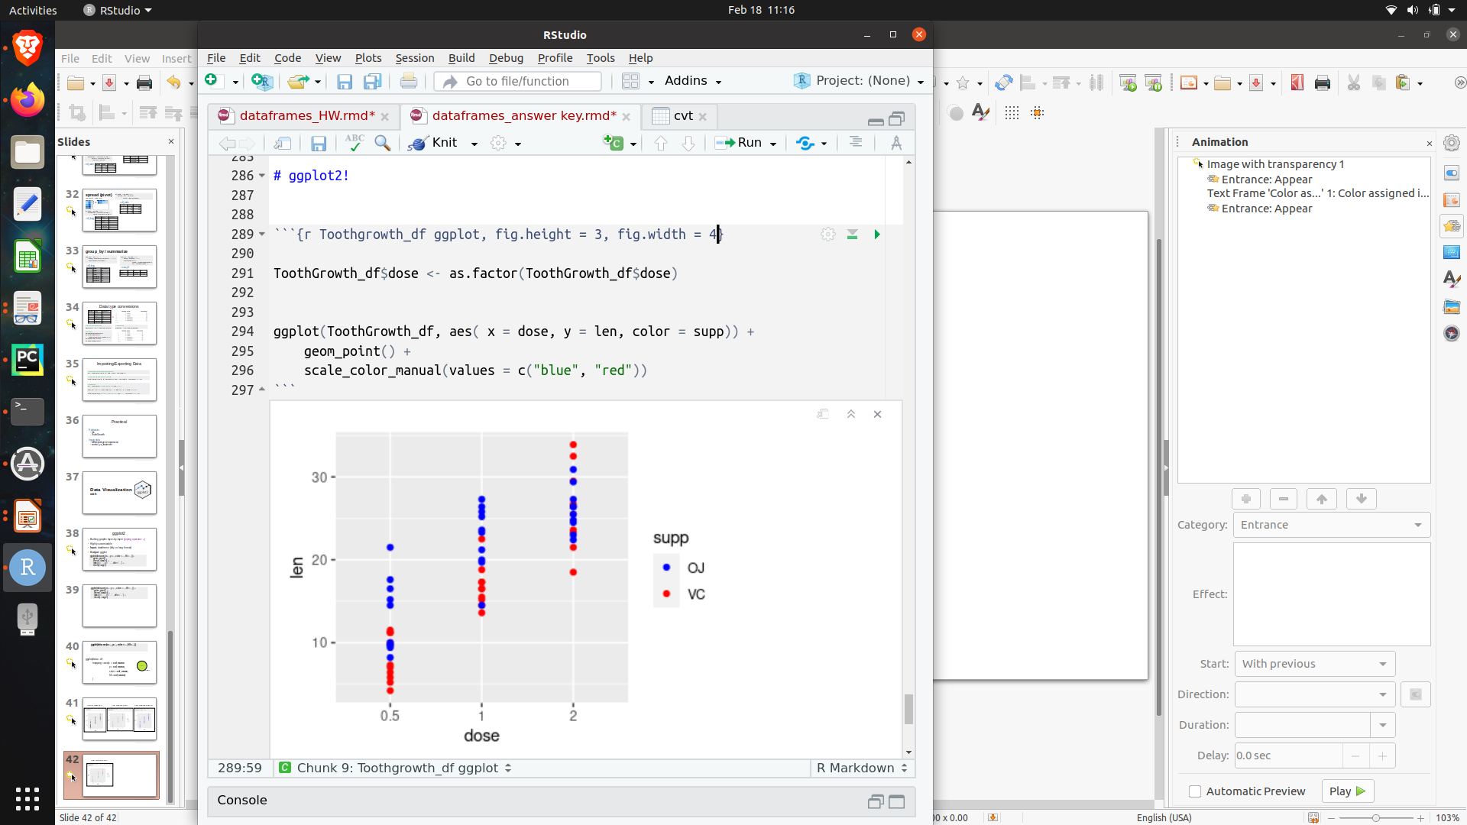
Customize colors in scale_color_manual(values = c(“…”))
Color assigned in aes()
Also see scale_fill_manual( values = c(“…”))
Number of values ≥ number of unique “supp” values
Order of “supp” values = factor level

Slide 50
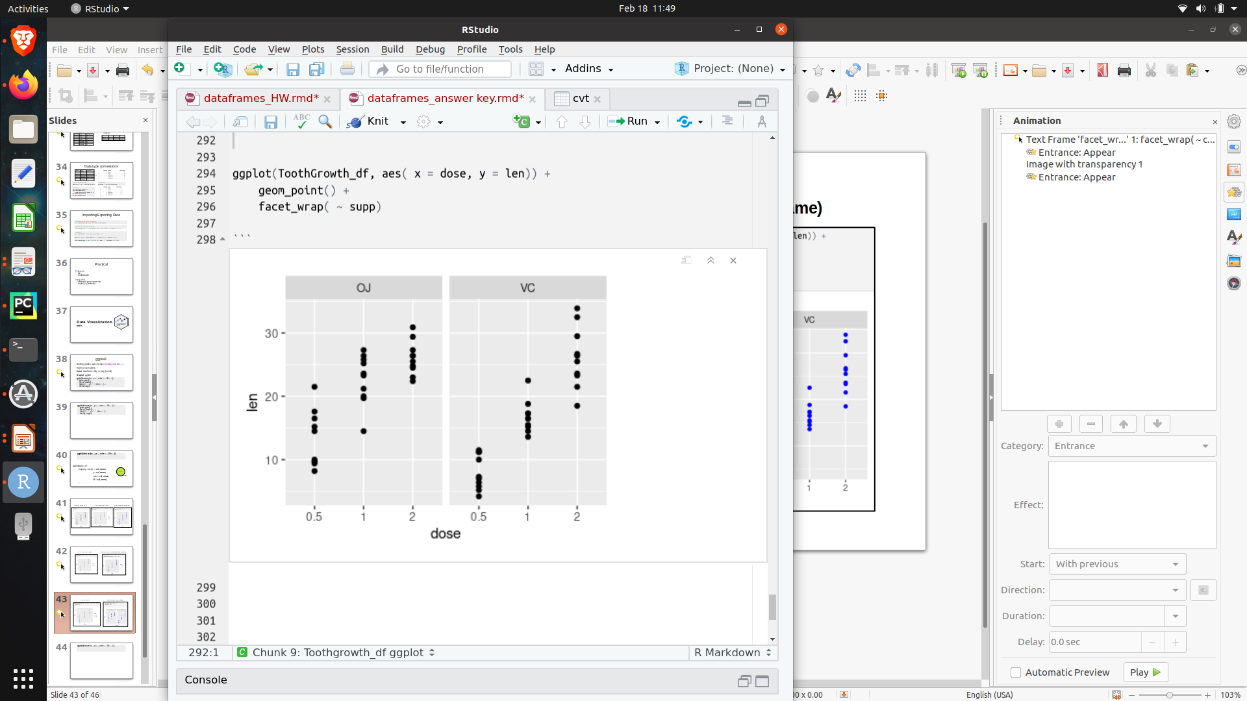
facet_wrap( ~ col_name)
Color assigned in aes()
Also see facet_grid(col_name ~ col_name)

Slide 51
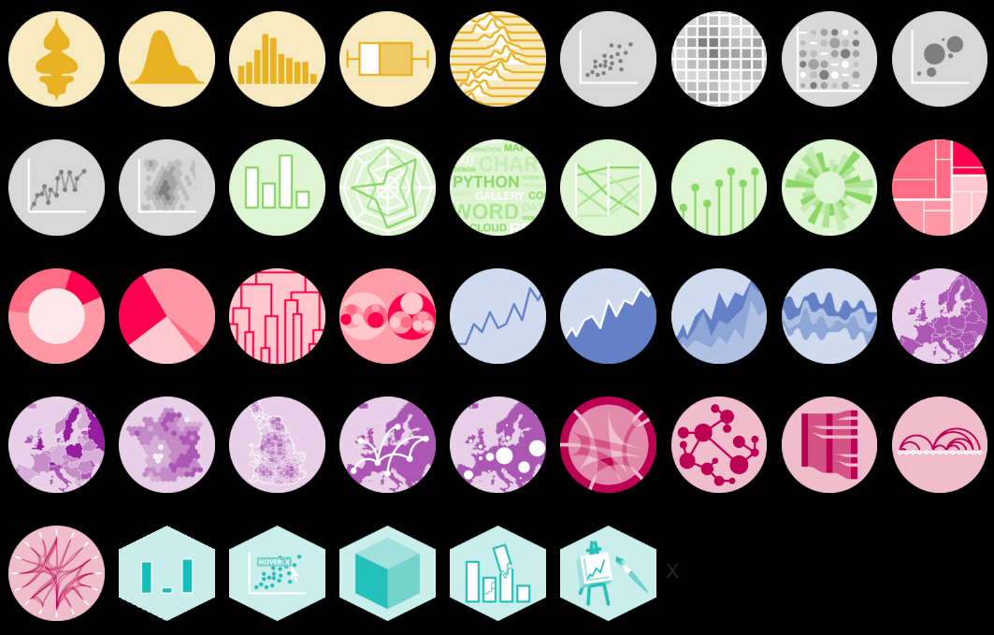
ggplot(df, aes(x=…, y=…, color = …, fill = …)) +
geom_point()
ggplot(df, aes(x=…, y=…, color = …, fill = …)) +
geom_point generates a dot plot, but there are many other geoms/graphs
Other types of graphs:
https://www.r-graph-gallery.com/

Slide 52
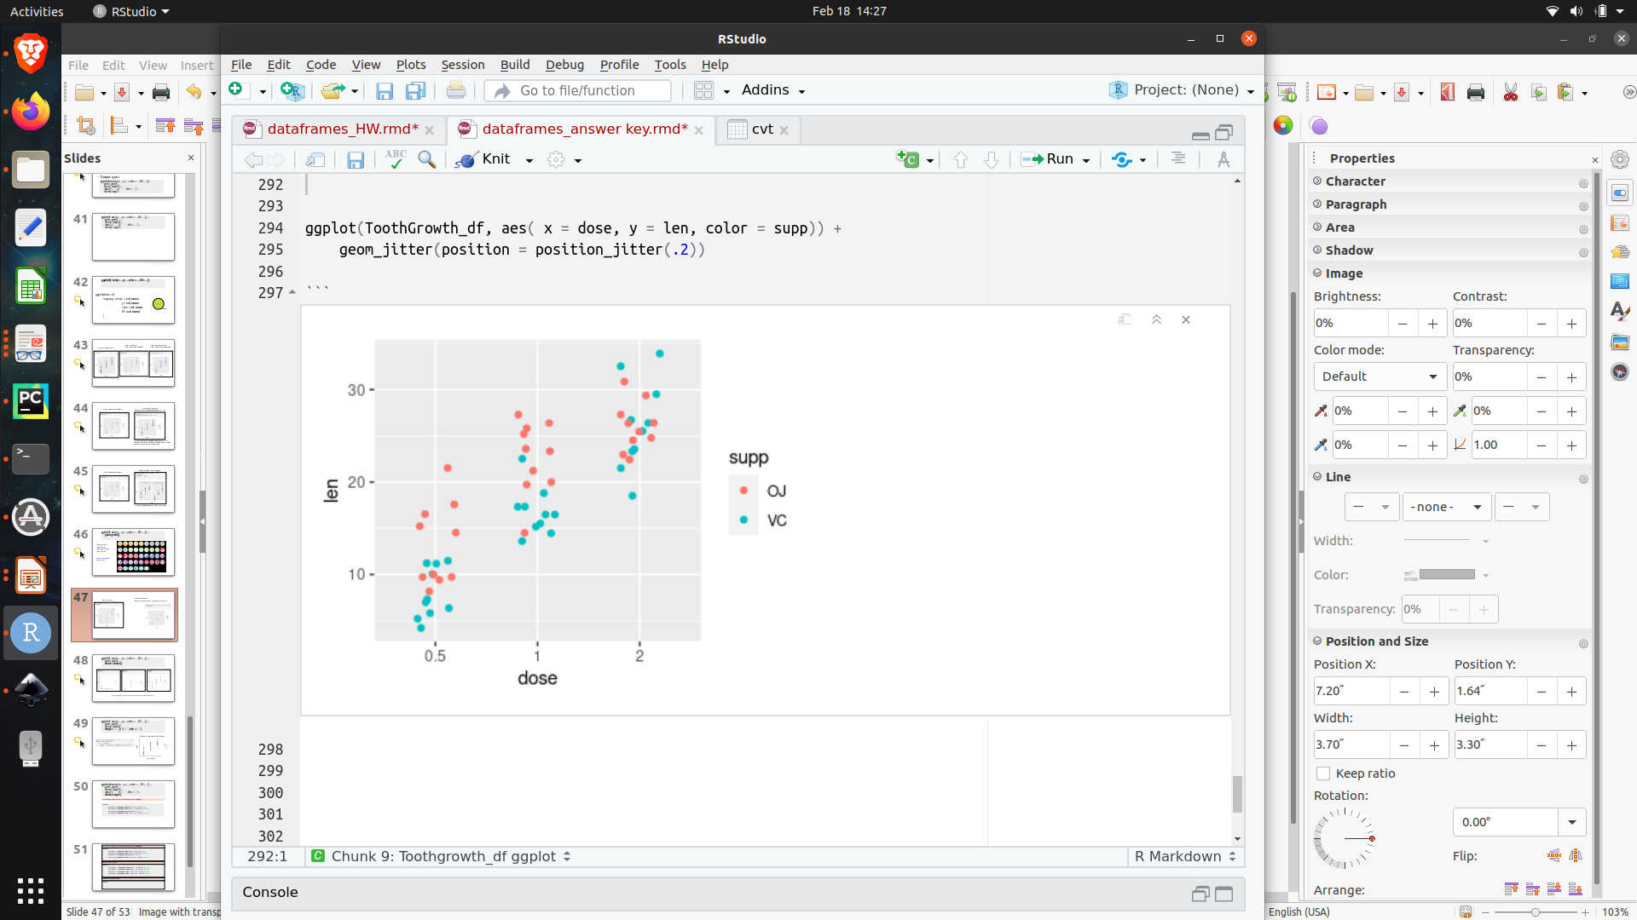
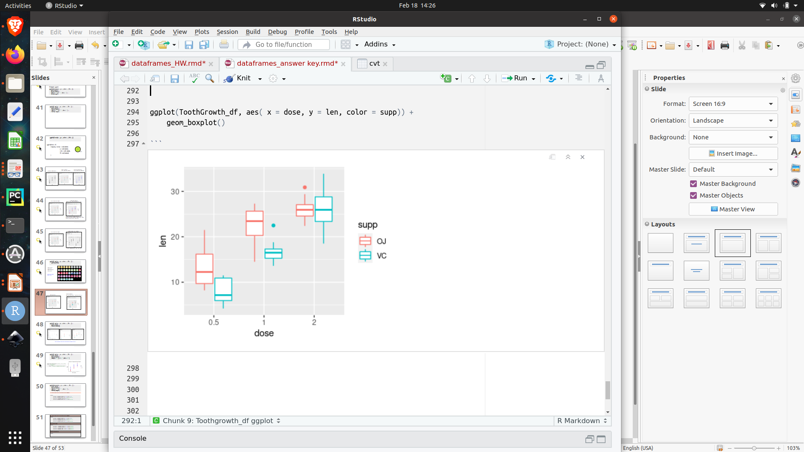
geom_point()
geom_jitter()
geom_boxplot()

Slide 53
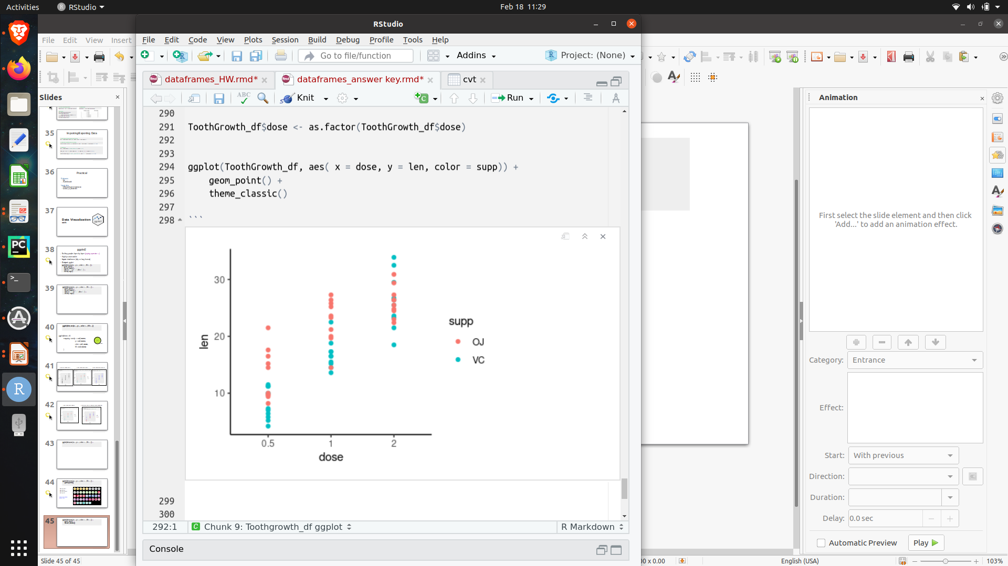
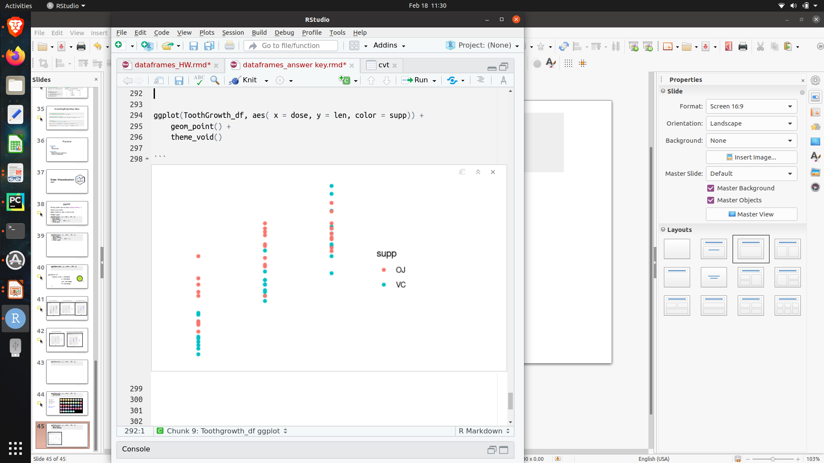
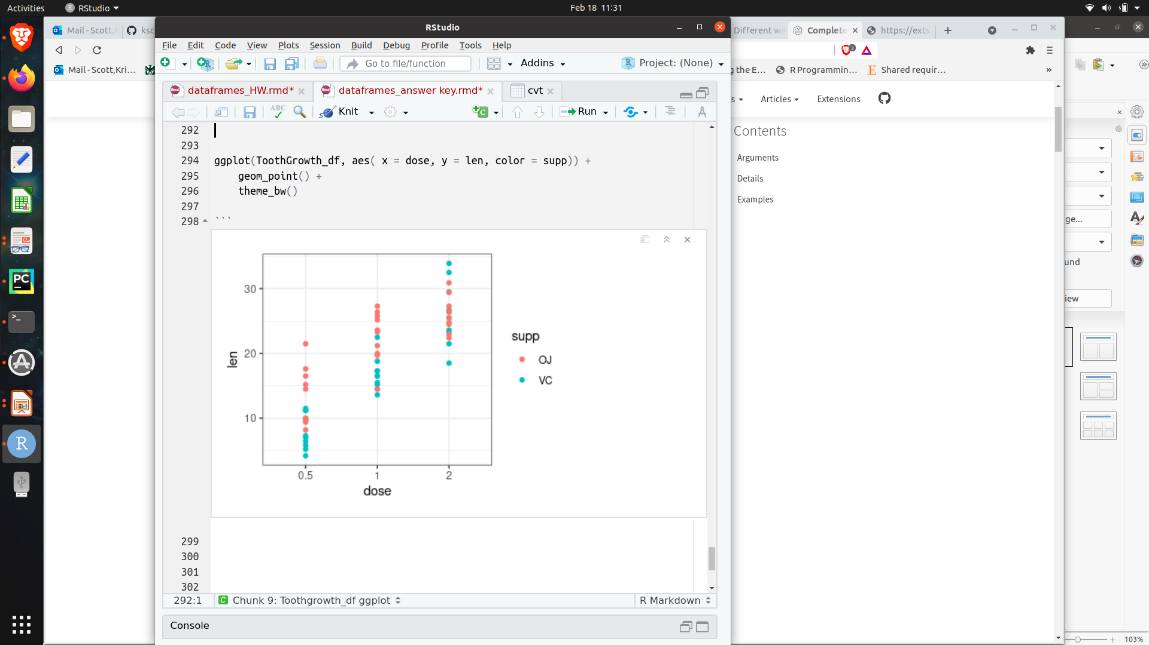
ggplot(df, aes(x=…, y=…, color = …, fill = …)) +
geom_point() +
theme_classic()
theme_classic()
theme_void()
theme_bw()
Other themes: https://ggplot2.tidyverse.org/reference/ggtheme.html

Slide 54
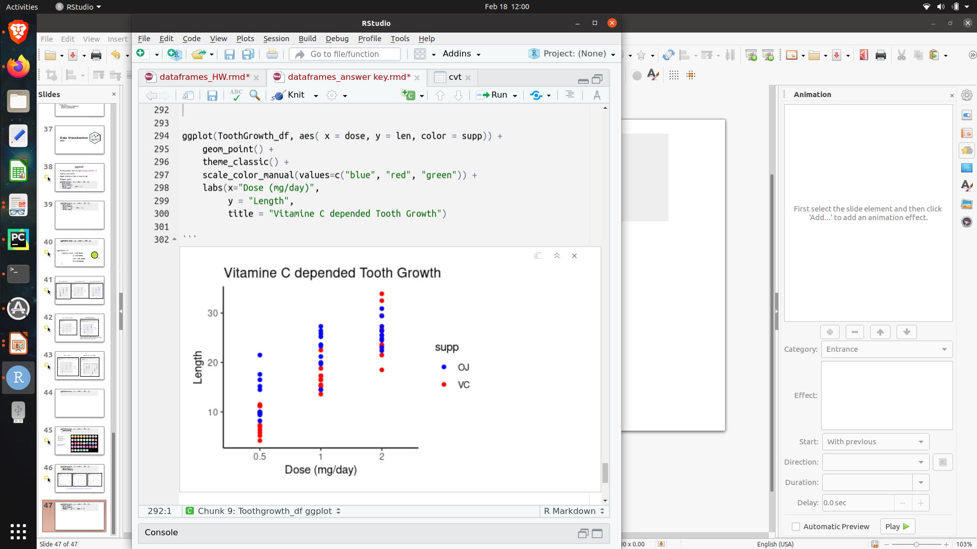
ggplot(df, aes(x=…, y=…, color = …, fill = …)) +
geom_point() +
theme_classic() +
labs(x = “…”, y = “…” , title = “...”)

Slide 55
ggplot(data, aes(x=…, y=…, color = …, fill = …)) +
geom_point() +
theme_classic() +
labs(x = “…”, y = “…” , title = “...”) +
theme(<args>)
themes() allows you to customize text options and more!

Slide 56
All text on graph can be customized using theme()
theme(
plot.title = element_text(hjust = 0.5, size = 14, color = “pink”),
axis.title = element_text(size = 10, color="black"),
axis.text = element_text(size = 10, color="black"),
axis.ticks = element_line(color="red" ) )
axis customization
theme(
axis.text.x = element_text(size = 10, color="black"),
axis.text.y = element_text(size = 10, color="black"),
axis.title.x = element_text(size = 10, color="black"),
axis.title.y = element_text(size = 10, color="black") )
legend customization http://www.sthda.com/english/wiki/ggplot2-legend-easy-steps-to-change-the-position-and-the-appearance-of-a-graph-legend-in-r-software
theme(legend.position = c(5,5) , # coordinate position of legend
legend.title = element_text(size=10),
legend.text = element_text(size=10) )

Slide 57
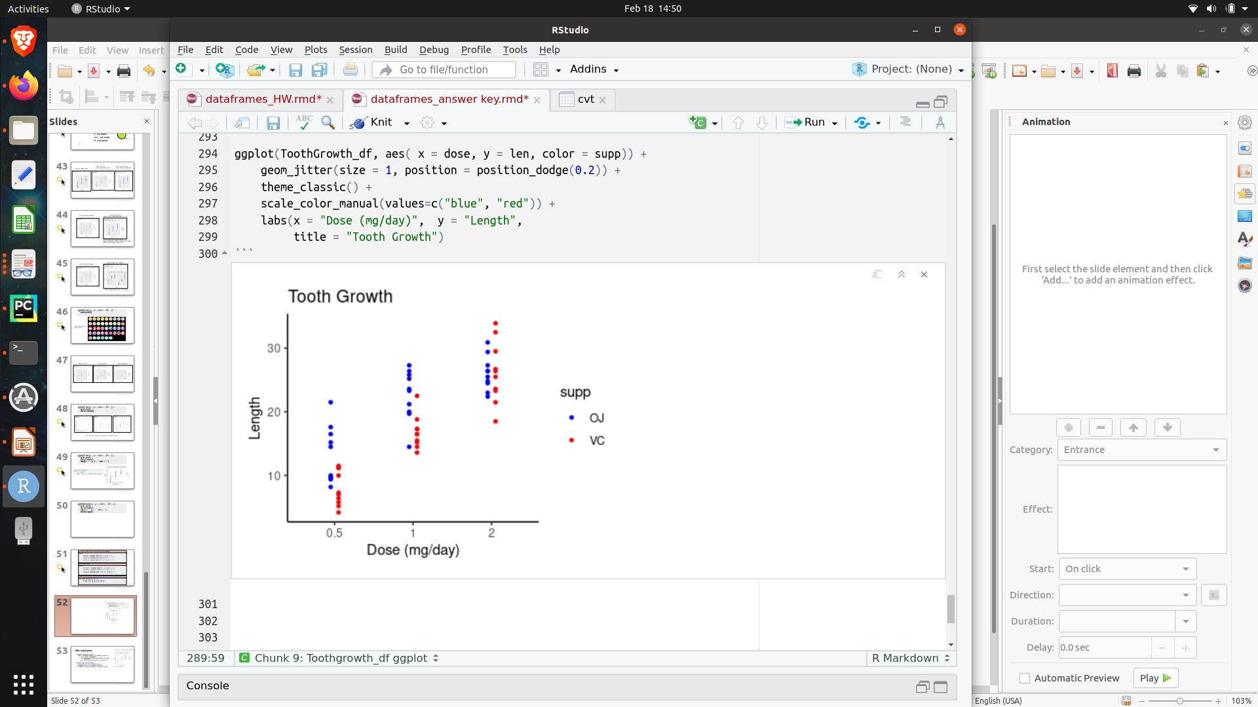
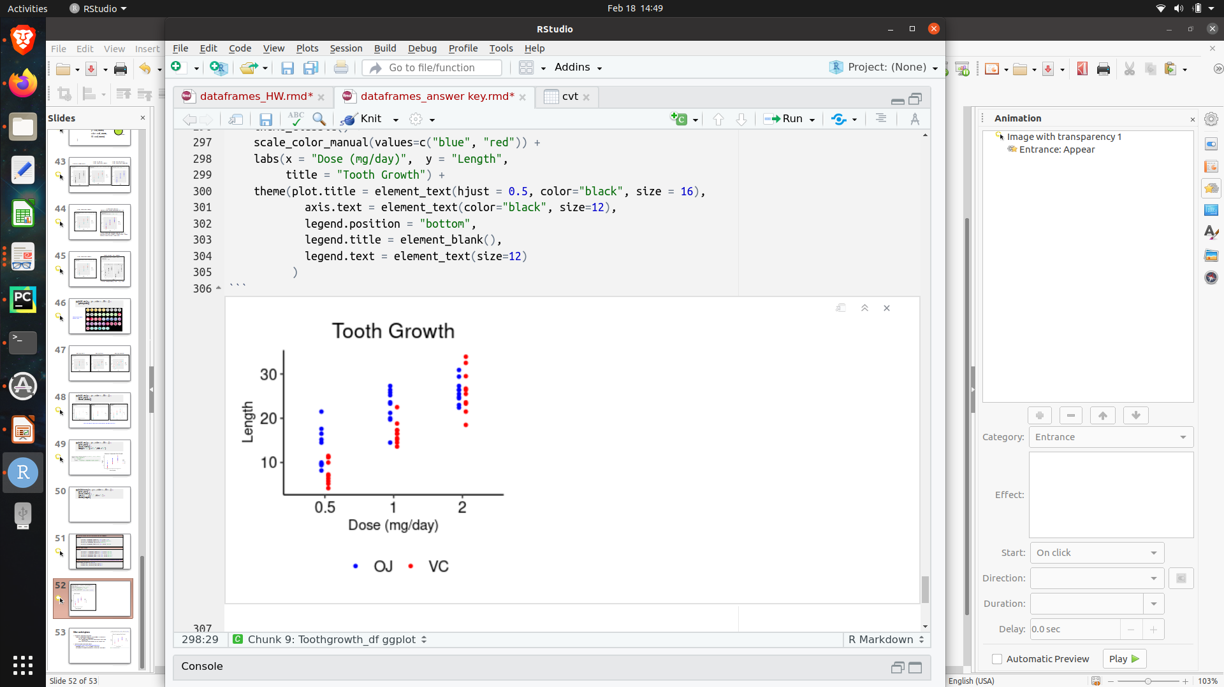

Slide 58
Save your graph https://ggplot2.tidyverse.org/reference/ggsave.html
ggsave(plot = <plot>, #default is last ggplot
filename = “plot.pdf”
path = “./path/to/destination/”,
device = “pdf”, #png, jpeg, ...
width = <inches>,
height = <inches>,
dpi = <dpi> #quality, dots per inch
Save your graph
ggsave(filename = “plot.pdf”, #you are able to skip the first argument
path = “./figures”,
device = “pdf”,
width = 4,
height = 3,
dpi = 200 )

Slide 59
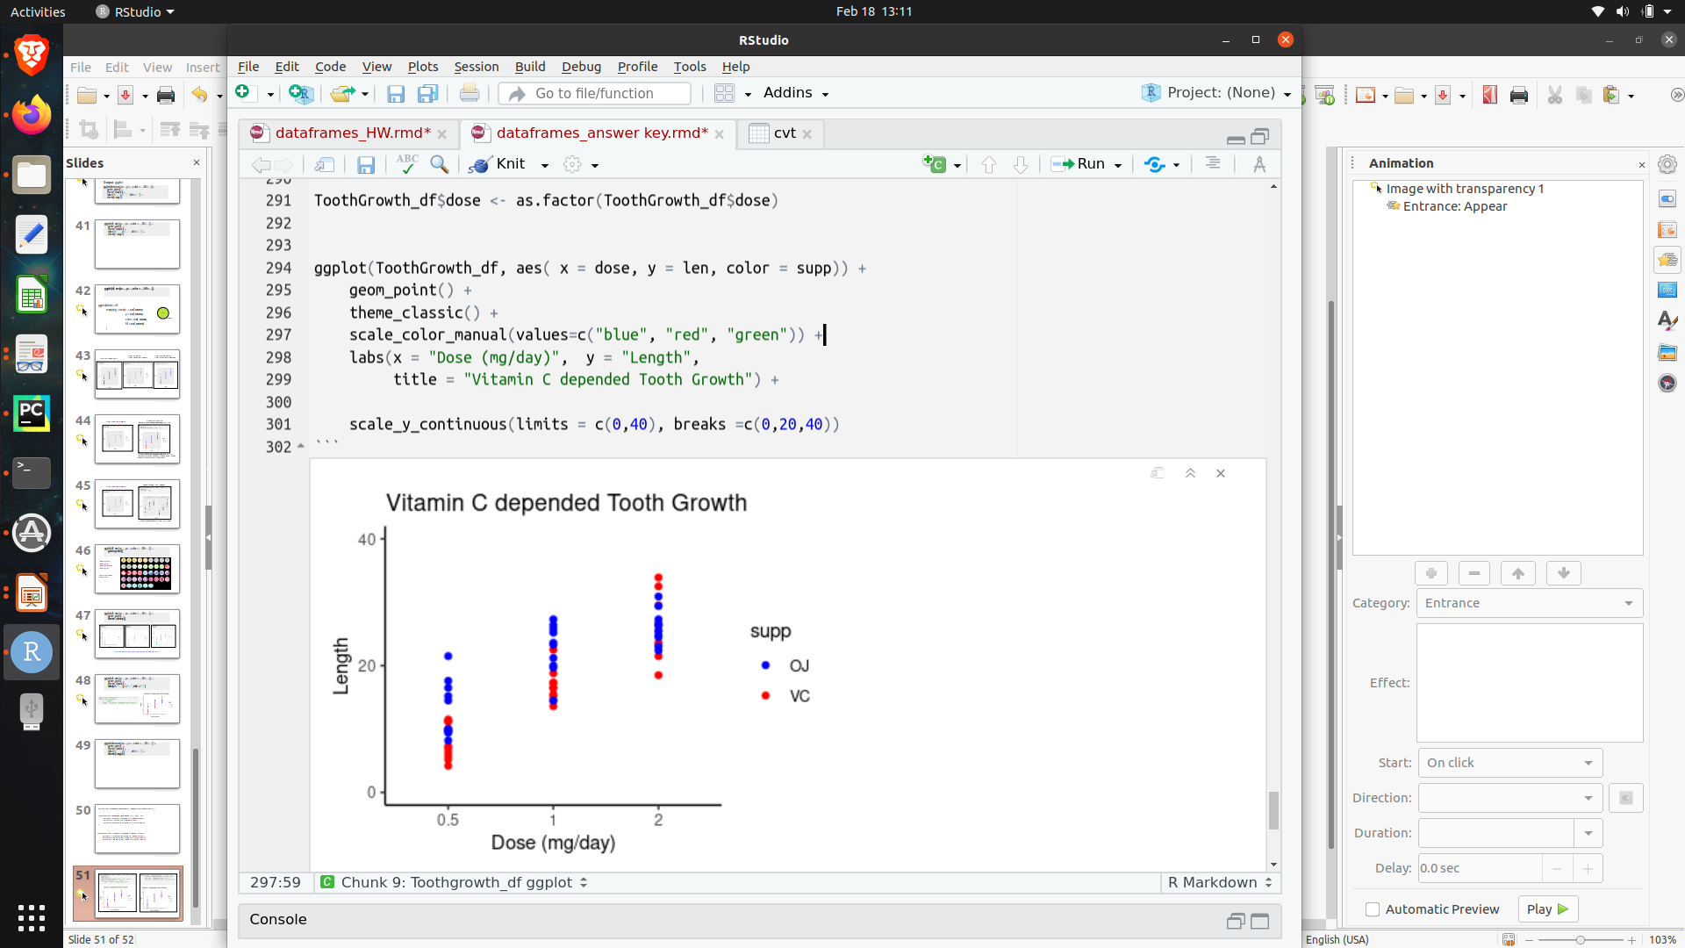
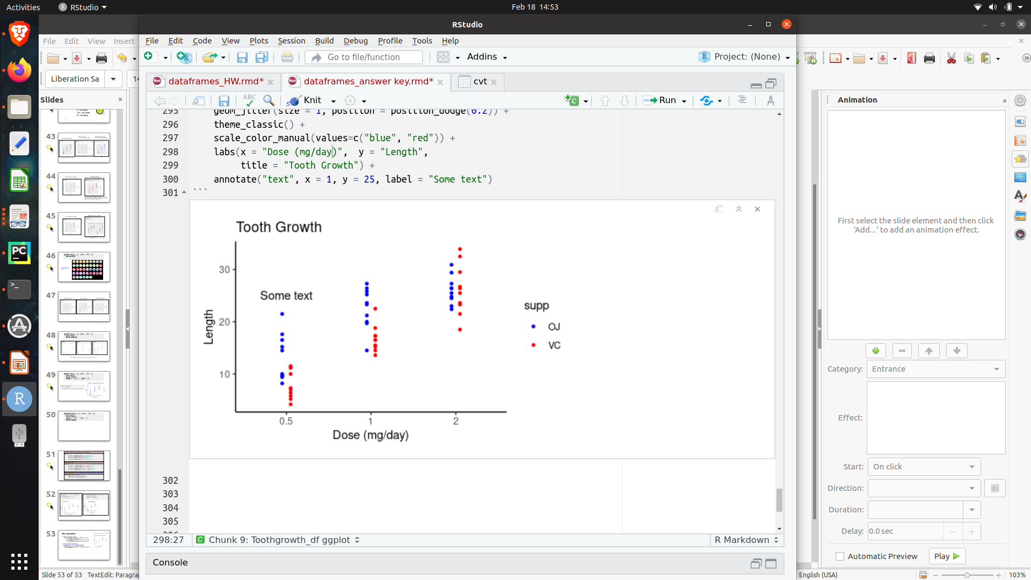
Other useful options:
Change axis break points and limits
scale_x_continuous(limits=c(0,100), breaks = (0,25,50,100) )
The x axis will have limits with a lower boud of 0 and upper bound of 100
The x axis tick marks will include 0, 25, 50, 75, and 100.
Also see scale_y_continuous()
Add text, shapes and lines to graphs https://ggplot2.tidyverse.org/reference/annotate.html
annotate("text", x = 1, y = 25, label = "Some text")
Will add text at coordinate positions 1,25 (x,y coordinates) that will say “Some text”

